Slide 1
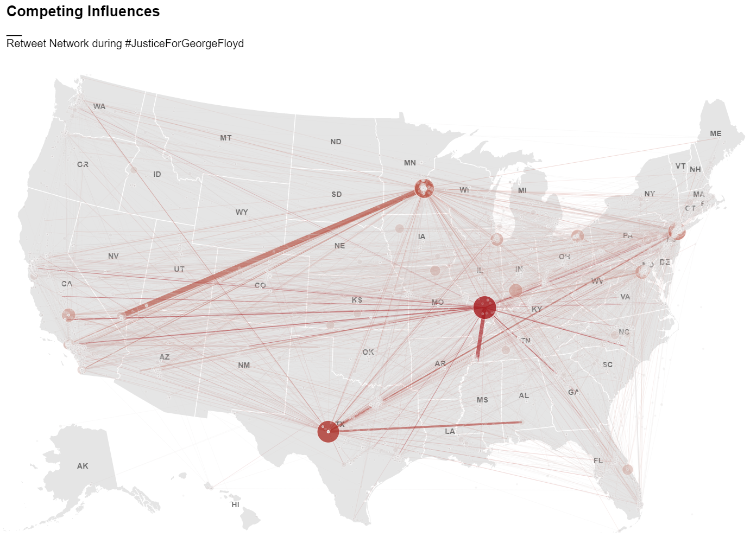



#Hashtags as a Means for Political Action
Exploring the Impact of Hashtag Activism on Political Processes Using Geolocated Social Media Posts Data
Leonardo Nicoletti

Slide 2
Overview
Research problem and research objectives
Methods and experimental design
Some results: Hashag Activism and Physical Protest

Slide 3
Problem Introduction
#Hashtag Activism today → crucial strategy for activists to influence social change
Lots of research in this field
Importance for shaping the structure of social movements
Importance for shaping political discourse and narratives
Last summer: #JusticeForGeorgeFloyd
Notes:
Today, # Hashtag Activism, the use of Twitter's hashtags to do activism online → crucial strategy for activists trying to influence social change
Over the past 2 decades there has been a lots of research in this field,
Importance for shaping the structure of social movements
Importance for shaping political discourse and narratives
Last year, we’ve all seen how one hashtag, #justiceforgeorgefloyd, has led to millions of people protesting in the US and worldwide and challenge the very existence of a long time institution (police)

Slide 4

Theoretical Level
Digital Protest
Political Processes
(i.e. political discourse, physical protest, voter behaviour, legislature etc.)
Notes:
Theoretical and anecdotal evidence that #activism can have real political consequences BUT

Slide 5
Theoretical Level
Digital Protest
Political Processes
(i.e. political discourse, physical protest, voter behaviour, legislature etc.)
But… Empirical Evidence?
Notes:
Lack of empirical evidence supporting this understanding through quantitative analysis

Slide 6
Digital Protest
?
?
Physical Protest
Notes:
Existing research:
impact of #activism on physical protest: disagreement

Slide 7
Digital Protest
?
?
?
?
Physical Protest
Legislative change
Notes:
Existing research:
impact of #activism on physical protest: disagreement
impact of #activism on legislative action: barely exists

Slide 8

Digital Protest
?
?
?
?
Physical Protest
Legislative change
Notes:
Existing research:
impact of #activism on physical protest: disagreement
impact of #activism on legislative action: barely exists
Our understanding of the spatial relationships between these processes is even more limited
Unresolved questions:
can social media activity in a specific geographical area influence legislative action within that same area?
can social media activity in a specific geographical area be used to predict where and when physical protests will take place?

Slide 9
Digital Protest
?
?
?
?
Physical Protest
Legislative change
geolocated social media data
relationship between hashtag activism and political processes
Notes:
More generally, a thorough understanding of how Geo-located data can help us understand the spatial relationship between hashtag activism and political processes is lacking

Slide 10
Research Question
How can location-based hashtag activism influence political processes in the United States?
Notes:
So, this is precisely the objective of my research: to build on top of the theoretical understanding that (networked) social movements can have political consequences, and to leverage geolocated social media data to provide an evidence based understanding of the political implications of hashtag activism.

Slide 11
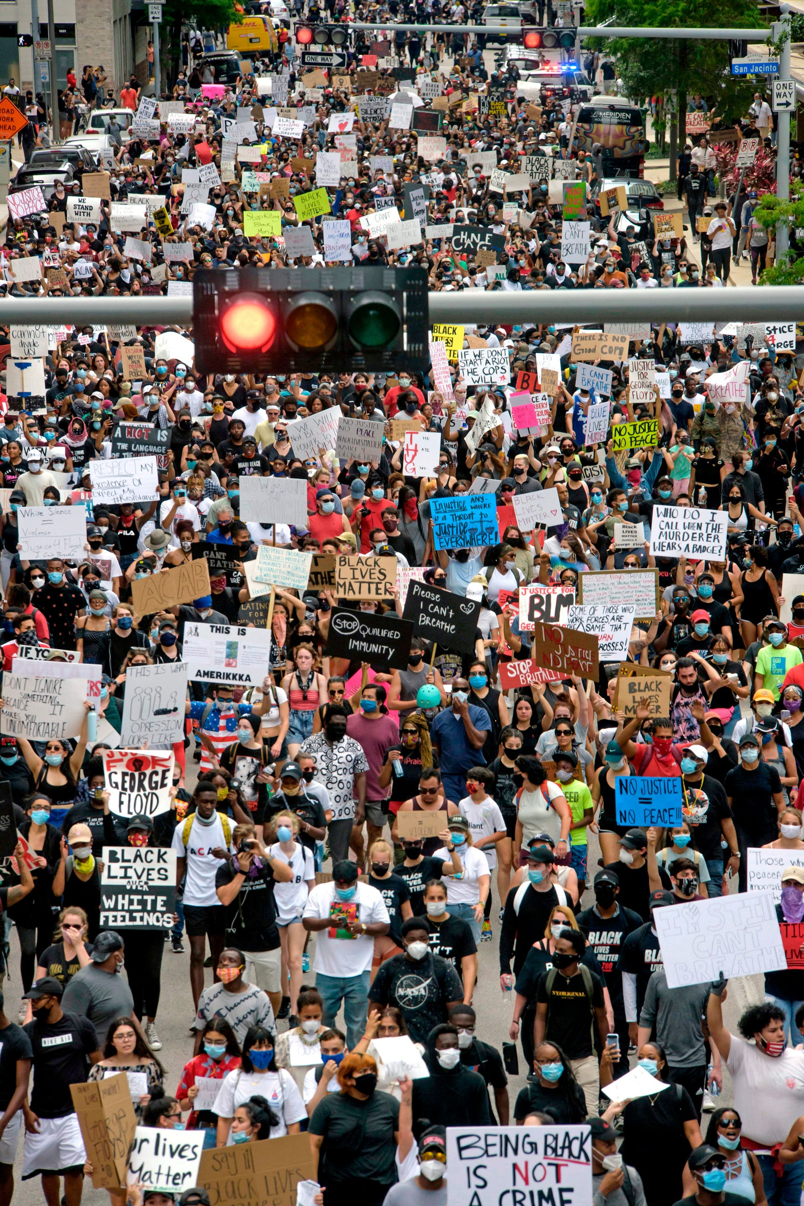
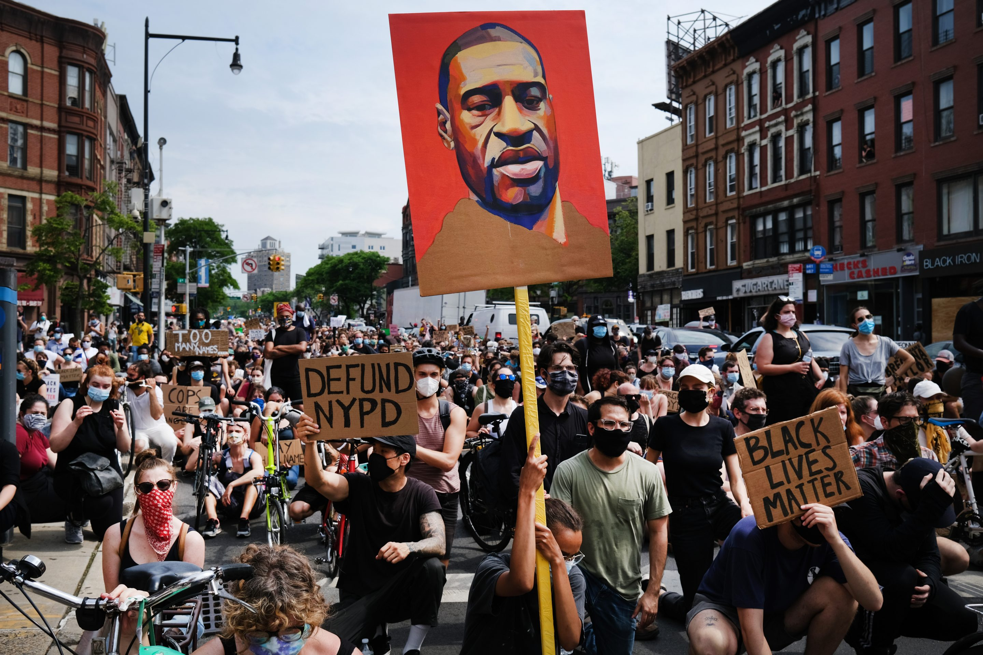
Case Study
Justice For George Floyd
5 data-sets
geo-located Twitter data from Twitter API
geo-located protest data from ACLED
data on legislatives responses to policing from NCSL
data on 2016/2020 county/precinct level election results
2020 census demographic data
Data Science approach
Web scraping
Geospatial data analysis
Network Analysis
ML (classification, regression, clustering)
Notes:
How am I doing this?
First, I am using the social media movement #JusticeForGeorgeFloyd of last summer as a case study to drive this research
the social significance of the #JusticeForGeorgeFloyd social movement, the intense use of social media during the movement, its geographic coverage in terms of physical protest, and the still-ongoing political activity related to the movement make this case highly relevant for the study of the political implications of hashtag activism.

Slide 12
Methods and Experimental design
Data Sources
US Census Bureau
ACLED
Twitter API v2
NCSL
Web scraping
Data Collection
2016 county shapes and demographics
Geo-located social media posts and geo-located physical protests
State level legislative responses to policing
Notes:
Ok so lets look at the methods in which I use and the experimental design for this research
I use 5 data-sets
1M geo-located tweets data from Twitter API
geo-located protest data from ACLED (the Armed Conflict Location & Event Data Project)
data on legislatives responses to policing from NCSL (National Council for State Legislatures)→ currently trying to find a more granular dataset
2020 census demographic data

Slide 13
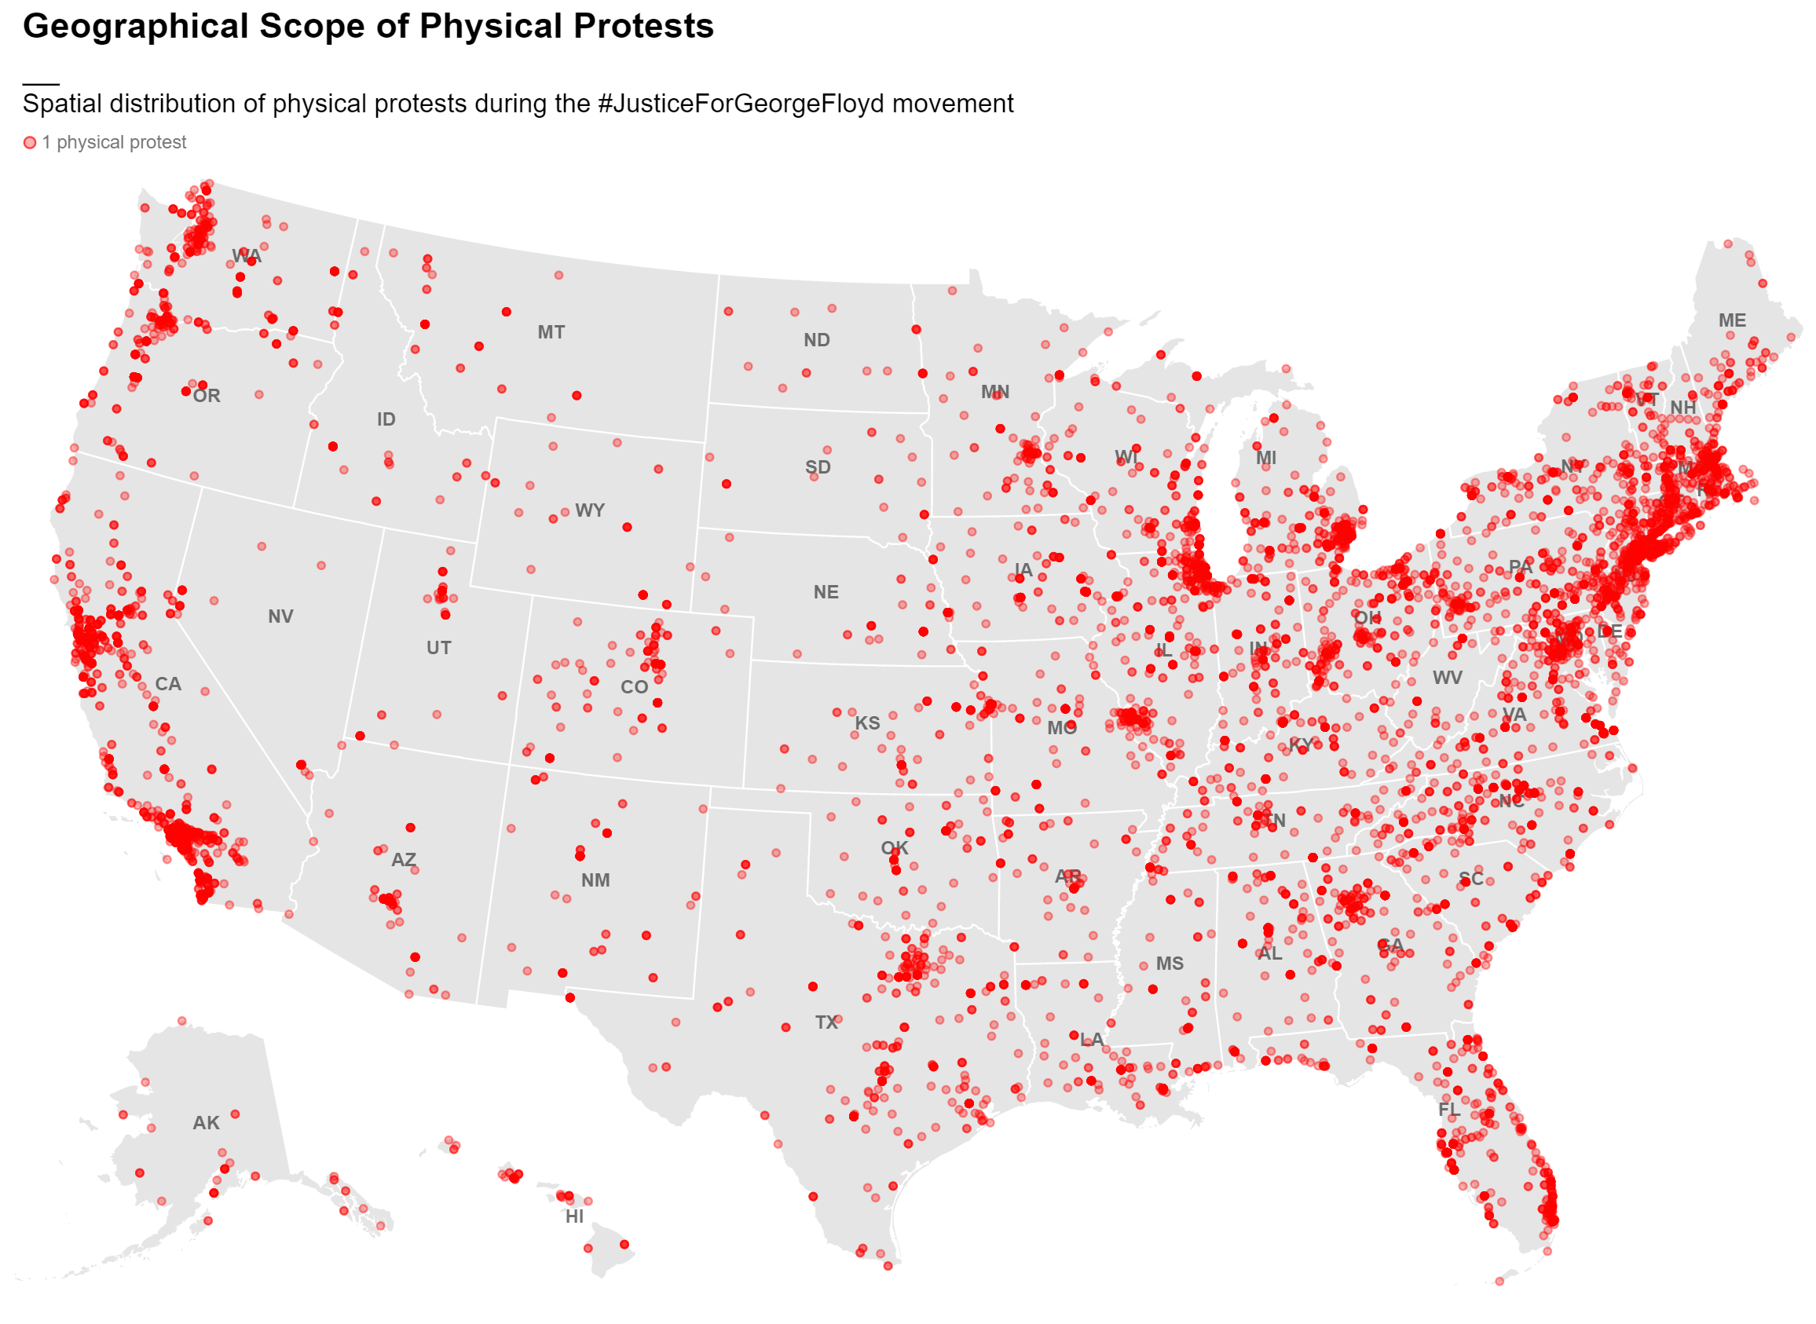
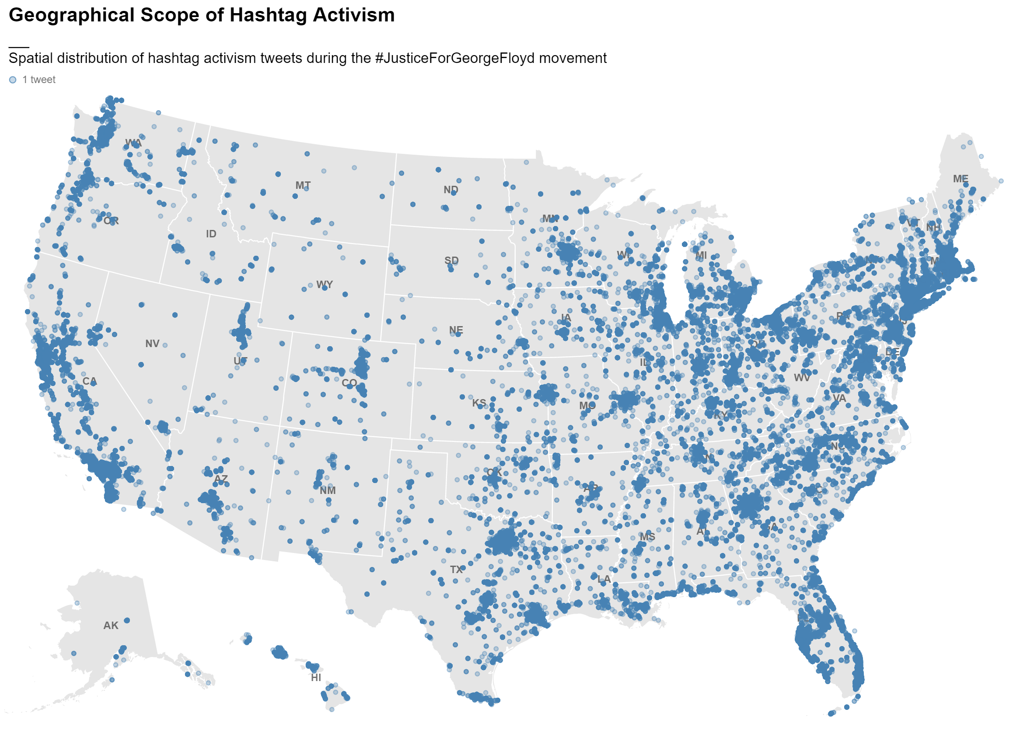
Methods and Experimental design
Data Sources
US Census Bureau
ACLED
Twitter API v2
NCSL
Web scraping
Data Collection
2016 county shapes and demographics
Geo-located social media posts and geo-located physical protests
State level legislative responses to policing
• 1 physical protest
• 1 social movement tweet
Notes:
The two primary data-sets for this research, geolocated tweets, and geolocated physical protests, are open source and available for the whole world. Which makes it possible to repeat this study for different social movements in different parts of the world.

Slide 14
Methods and Experimental design
Data Sources
US Census Bureau
ACLED
Twitter API v2
NCSL
Web scraping
Data Collection
2016 county shapes and demographics
Geo-located social media posts and geo-located physical protests
State level legislative responses to policing
Data Preprocessing
Data aggregated by county (raw count, population normalized count, network weighted count)
Data aggregated by day (count)
Geo-located social network
Data aggregated by state (number of legislative responses)
Notes:
I use a number of pre-processing techniques to clean this data
Mainly I use the county and state geographies to aggregate counts of physical protests, tweets and legislative responses in total.
I also aggregate this data by day at the national, state, and county scale.
Finally, I use tweets to create a geo-located social network

Slide 15
Methods and Experimental design
Data Sources
US Census Bureau
ACLED
Twitter API v2
NCSL
Web scraping
Data Collection
2016 county shapes and demographics
Geo-located social media posts and geo-located physical protests
State level legislative responses to policing
Data Preprocessing
Data aggregated by county (raw count, population normalized count, network weighted count)
Data aggregated by day (count)
Geo-located social network
Data aggregated by state (number of legislative responses)
Time series modelling
Correlated time series analysis
Granger causality + cointegration
Multivariate time-series forecasting (VAR, LSTM)
Notes:
Third, let me introduce the first modelling technique: time series modelling
This method is used to perform correlated time series analysis, which I use to understand the correlation between tweet and protest time series at different time lags
I also use granger causality analysis, which is used to infer potential causal relationships between time series
Finally, in this part of the analysis I select and build a forecasting model to test whether one time series can be used to predict the other

Slide 16
Methods and Experimental design
Data Sources
US Census Bureau
ACLED
Twitter API v2
NCSL
Web scraping
Data Collection
2016 county shapes and demographics
Geo-located social media posts and geo-located physical protests
State level legislative responses to policing
Data Preprocessing
Data aggregated by county (raw count, population normalized count, network weighted count)
Data aggregated by day (count)
Geo-located social network
Data aggregated by state (number of legislative responses)
Time series modelling
Correlated time series analysis
Granger causality + cointegration
Multivariate time-series forecasting (VAR, LSTM)
Regression Analysis
tweets vs. physical protests
tweets vs. legislation count
Physical protest vs. legislation count
Notes:
The second modelling technique is regression analysis: this technique is used to model linear and power relationships between variables
I use regression analysis when looking at total counts of tweets, protests and legislation
And I use regression in combination with time series modelling, to understand linear relationships between variables as they change over time and at different time lags

Slide 17
Methods and Experimental design
Data Sources
US Census Bureau
ACLED
Twitter API v2
NCSL
Web scraping
Data Collection
2016 county shapes and demographics
Geo-located social media posts and geo-located physical protests
State level legislative responses to policing
Data Preprocessing
Data aggregated by county (raw count, population normalized count, network weighted count)
Data aggregated by day (count)
Geo-located social network
Data aggregated by state (number of legislative responses)
Time series modelling
Correlated time series analysis
Granger causality + cointegration
Multivariate time-series forecasting (VAR, LSTM)
Regression Analysis
tweets vs. physical protests
tweets vs. legislation count
Physical protest vs. legislation count
Network Modelling
Centrality metrics
Community detection
Network spatial interactions
Notes:
Third, I use network modelling to calculate centrality metrics, extract communities, and explore how these metrics relate to space

Slide 18
Methods and Experimental design
Data Sources
US Census Bureau
ACLED
Twitter API v2
NCSL
Web scraping
Data Collection
2016 county shapes and demographics
Geo-located social media posts and geo-located physical protests
State level legislative responses to policing
Data Preprocessing
Data aggregated by county (raw count, population normalized count, network weighted count)
Data aggregated by day (count)
Geo-located social network
Data aggregated by state (number of legislative responses)
Time series modelling
Correlated time series analysis
Granger causality + cointegration
Multivariate time-series forecasting (VAR, LSTM)
Regression Analysis
tweets vs. physical protests
tweets vs. legislation count
Physical protest vs. legislation count
Network Modelling
Centrality metrics
Community detection
Network spatial interactions
= Geospatial Analysis
Notes:
Finally, I use geo-spatial analysis throughout each computational phase to explore how these metrics relate to space

Slide 19
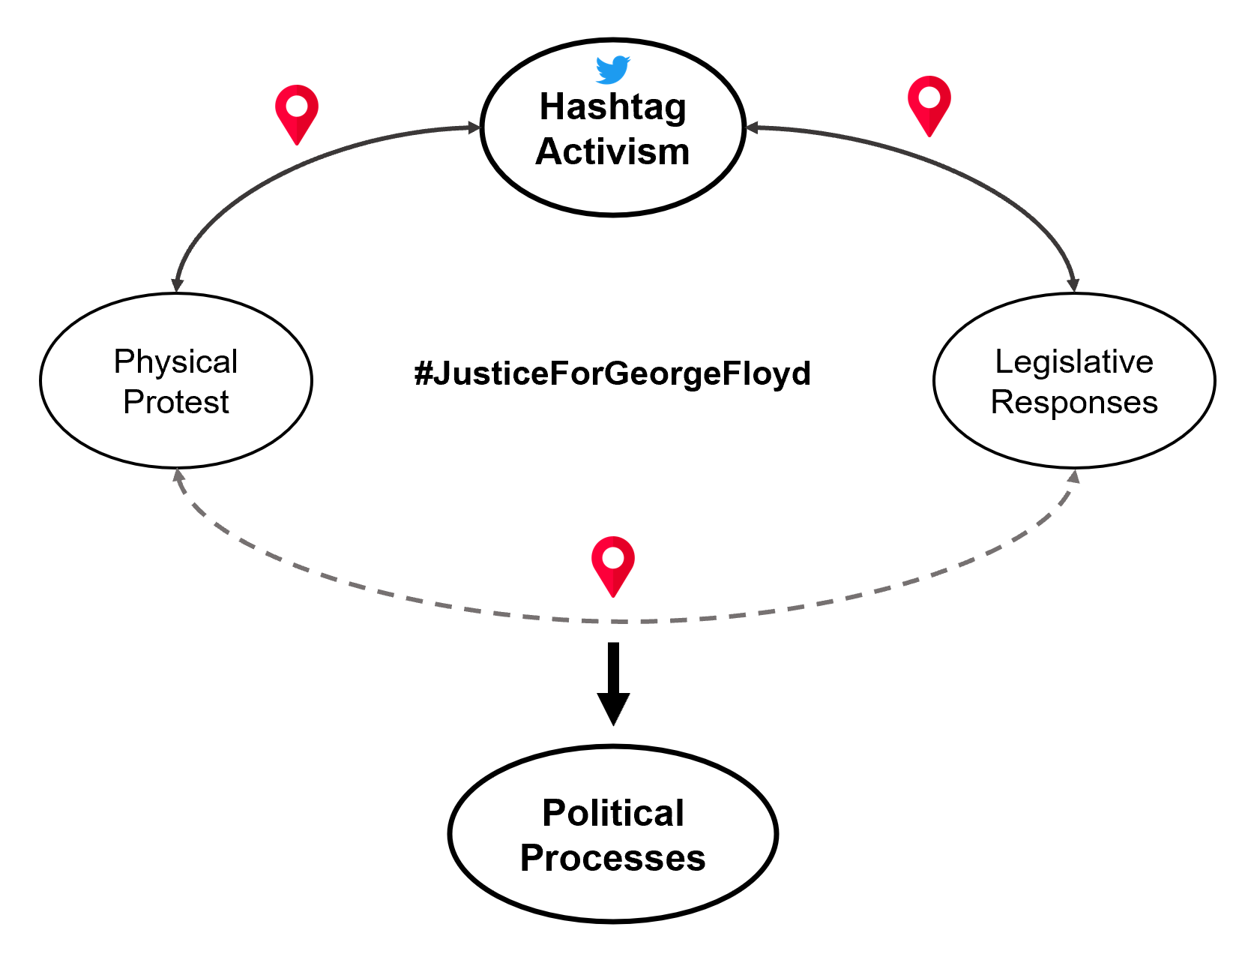
Notes:
Let’s focus on one of the main outcomes of this research: What is the relationship between location-based hashtag activism and physical protest activity?
As I mentioned earlier, the study of the relationship between hashtag activism and physical protest has been inconclusive, with evidence both in support and against the existence of such a relationship. This, scholars conclude, is partly due to a lack of empirical research and the use of limited case studies. Additionally, most of the literature within this area of research has studied this relationship through a broad lens without considering the geo-spatial relationships that may exist between digital and physical protests. So, in an attempt to address this knowledge gap, I’m going to share some evidence, using the JusticeForGeorgeFloyd social movement as a case study, suggesting that there is in fact a strong temporal and spatial relationship between hashtag activism and physical protest.

Slide 20
Methods
Data Sources
US Census Bureau
ACLED
Twitter API v2
NCSL
Web scraping
Data Collection
2016 county shapes and demographics
Geo-located social media posts and geo-located physical protests
State level legislative responses to policing
SPACE
Data Preprocessing
Data aggregated by county (raw count, population normalized count, network weighted count)
Data aggregated by day (count)
Data aggregated by state (number of legislative responses)
TIME
Time series modelling
Correlated time series analysis
TLCC + Granger causality
Multivariate time-series forecasting (LSTM, VAR)
RELATION
Regression Analysis
tweets vs. physical protests
tweets vs. legislation count
Physical protest vs. legislation count
= Geospatial Analysis
Notes:
Finally, I use geo-spatial analysis throughout each computational phase to explore how these metrics relate to space

Slide 21
Methods
Data Sources
US Census Bureau
ACLED
Twitter API v2
NCSL
Web scraping
Data Collection
2016 county shapes and demographics
Geo-located social media posts and geo-located physical protests
State level legislative responses to policing
• 1 physical protest
• 1 social movement tweet
Notes:
The two primary data-sets for this research, geolocated tweets, and geolocated physical protests, are open source and available for the whole world. Which makes it possible to repeat this study for different social movements in different parts of the world.

Slide 22
Digital Protest and Physical Protest: Evidence from #JusticeForGeorgeFloyd
Notes:
Let’s focus on one of the main outcomes of this research: What is the relationship between location-based hashtag activism and physical protest activity?
As I mentioned earlier, the study of the relationship between hashtag activism and physical protest has been inconclusive, with evidence both in support and against the existence of such a relationship. This, scholars conclude, is partly due to a lack of empirical research and the use of limited case studies. Additionally, most of the literature within this area of research has studied this relationship through a broad lens without considering the geo-spatial relationships that may exist between digital and physical protests. So, in an attempt to address this knowledge gap, I’m going to share some evidence, using the JusticeForGeorgeFloyd social movement as a case study, suggesting that there is in fact a strong temporal and spatial relationship between hashtag activism and physical protest.

Slide 23
positive MPE/high relationship
negative MPE/high relationship
positive MPE/low relationship
R2
MPE
negative MPE/low relationship
Notes:
Let’s focus on one of the main outcomes of this research: What is the relationship between location-based hashtag activism and physical protest activity?
As I mentioned earlier, the study of the relationship between hashtag activism and physical protest has been inconclusive, with evidence both in support and against the existence of such a relationship. This, scholars conclude, is partly due to a lack of empirical research and the use of limited case studies. Additionally, most of the literature within this area of research has studied this relationship through a broad lens without considering the geo-spatial relationships that may exist between digital and physical protests. So, in an attempt to address this knowledge gap, I’m going to share some evidence, using the JusticeForGeorgeFloyd social movement as a case study, suggesting that there is in fact a strong temporal and spatial relationship between hashtag activism and physical protest.

Slide 24
Notes:
Let’s focus on one of the main outcomes of this research: What is the relationship between location-based hashtag activism and physical protest activity?
As I mentioned earlier, the study of the relationship between hashtag activism and physical protest has been inconclusive, with evidence both in support and against the existence of such a relationship. This, scholars conclude, is partly due to a lack of empirical research and the use of limited case studies. Additionally, most of the literature within this area of research has studied this relationship through a broad lens without considering the geo-spatial relationships that may exist between digital and physical protests. So, in an attempt to address this knowledge gap, I’m going to share some evidence, using the JusticeForGeorgeFloyd social movement as a case study, suggesting that there is in fact a strong temporal and spatial relationship between hashtag activism and physical protest.

Slide 25
Notes:
Let’s focus on one of the main outcomes of this research: What is the relationship between location-based hashtag activism and physical protest activity?
As I mentioned earlier, the study of the relationship between hashtag activism and physical protest has been inconclusive, with evidence both in support and against the existence of such a relationship. This, scholars conclude, is partly due to a lack of empirical research and the use of limited case studies. Additionally, most of the literature within this area of research has studied this relationship through a broad lens without considering the geo-spatial relationships that may exist between digital and physical protests. So, in an attempt to address this knowledge gap, I’m going to share some evidence, using the JusticeForGeorgeFloyd social movement as a case study, suggesting that there is in fact a strong temporal and spatial relationship between hashtag activism and physical protest.

Slide 26
Notes:
Let’s focus on one of the main outcomes of this research: What is the relationship between location-based hashtag activism and physical protest activity?
As I mentioned earlier, the study of the relationship between hashtag activism and physical protest has been inconclusive, with evidence both in support and against the existence of such a relationship. This, scholars conclude, is partly due to a lack of empirical research and the use of limited case studies. Additionally, most of the literature within this area of research has studied this relationship through a broad lens without considering the geo-spatial relationships that may exist between digital and physical protests. So, in an attempt to address this knowledge gap, I’m going to share some evidence, using the JusticeForGeorgeFloyd social movement as a case study, suggesting that there is in fact a strong temporal and spatial relationship between hashtag activism and physical protest.

Slide 27
Digital Protest and Physical Protest: #JusticeForGeorgeFloyd; URB Updates
Notes:
Let’s focus on one of the main outcomes of this research: What is the relationship between location-based hashtag activism and physical protest activity?
As I mentioned earlier, the study of the relationship between hashtag activism and physical protest has been inconclusive, with evidence both in support and against the existence of such a relationship. This, scholars conclude, is partly due to a lack of empirical research and the use of limited case studies. Additionally, most of the literature within this area of research has studied this relationship through a broad lens without considering the geo-spatial relationships that may exist between digital and physical protests. So, in an attempt to address this knowledge gap, I’m going to share some evidence, using the JusticeForGeorgeFloyd social movement as a case study, suggesting that there is in fact a strong temporal and spatial relationship between hashtag activism and physical protest.

Slide 28
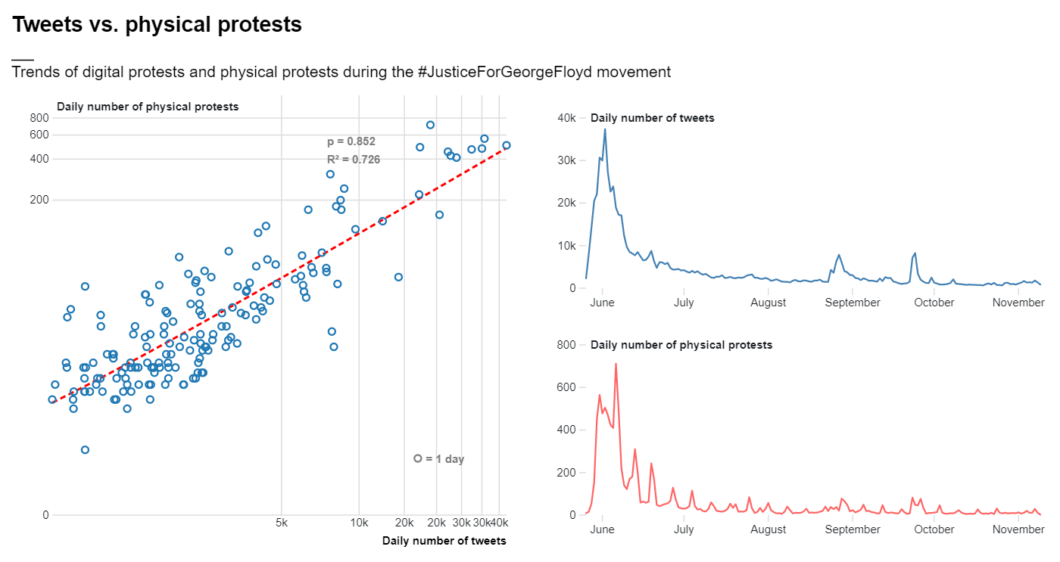
Notes:
In this slide you see the result of aggregating point data describing instances of hashtag activism and physical protests in time and space at the national scale
On your right, you have time series illustrating the temporal patterns of both hashtag activism (measured in number of tweets), and physical protests.
On your left you have a scatterplot illustrating the relationship between daily number of physical protests and daily number of tweets at the national scale
It can be observed that, at the national scale, hashtag activism bears a very strong positive relationship with physical protest activity. On days where people protested more on social media, people also protested more in the street, and vice versa. In the case of #JusticeForGeorgeFloyd, people used Twitter to express outrage about events of police brutality and to organize physical protests (CITE). During protests, more acts of police brutality were documented and shared on Twitter (CITE), which could have led to yet more protests and to more people showing up to protests, and so on.

Slide 29
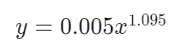
Notes:
This trend can be modelled by a power regression function represented by the red dashed line, where y is the number of physical protests that take place on a given day and x is the number of social movement tweets that are posted on a given day. This model is considerably accurate, with a Pearson regression score of 0.852 and an R2 score of 0.726.

Slide 30
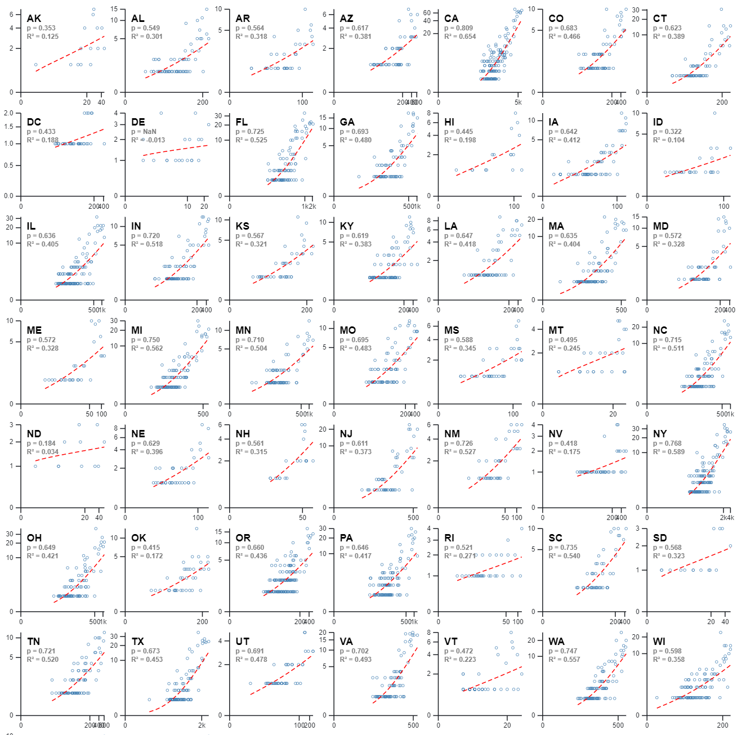
Median Pearson r = 0.74 Median r2 = 0.55
State Level
Notes:
In order to answer this question I aggregated physical protest counts AND social movement tweet counts both in time and in space (i.e. at the state level).
In this slide you can see the temporal and statistical relationship between daily number of physical protests and daily number of tweets as scatter-plots for each of the U.S.’s 51 states.
From this figure it is evident that the pattern previously observed at the national level also exists at the state level. As such, in spite of the existence of a few outliers, the relationship between hashtag activism and physical protest counts in each state is described by a strong positive correlation. Across 51 states, increased twitter activity on a specific day almost always results in increased counts of physical protests.
Additionally, similarly to the trend observed at the national scale, the relationship between state-level hashtag activism and physical protest counts can be modelled by a power regression function (yn=mxbn), represented by the red dashed line in each subplot, where y is the number of physical protests that take place on a given day in a given state and x is the number of social movement tweets that are posted on a given day in a given state. Considering the fact that we are modelling complex human behaviours, such models are fairly accurate, with a median R2 value of 0.55 across 51 states, and 37 states that are associated with R2 values greater than 0.5.

Slide 31
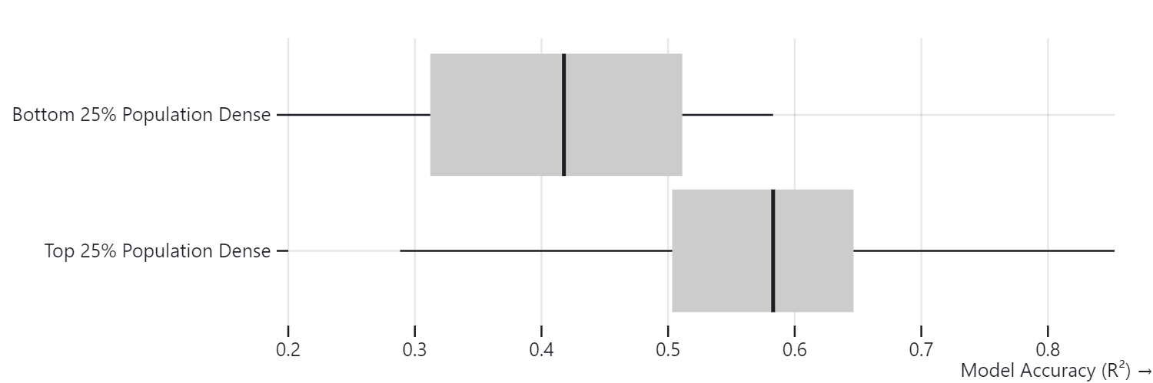
Notes:
Interestingly, across the top 25% most densely populated states, these models score even higher.
In contrast, the states where this relationship is weakest are also the more rural and least densely populated states (i.e. HI, ID, ME, ND, AK, AR, DE, MS, SD, WY, VT)

Slide 32
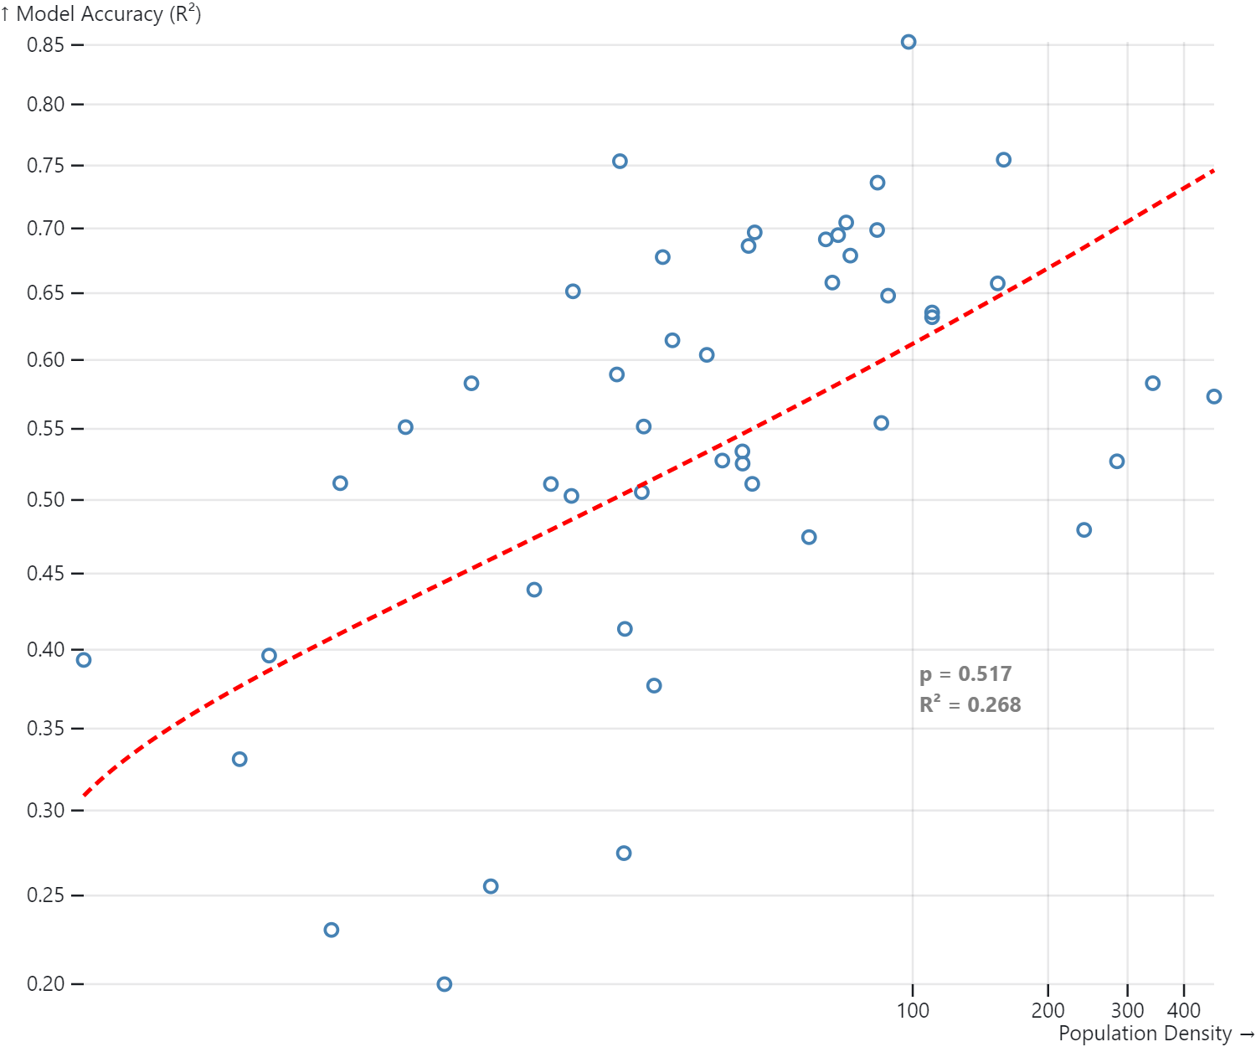
↑ population density = ↑ model accuracy
49 states (removed DC and DE which have really small landmass → very little data available)
Notes:
Interestingly, across the top 25% most densely populated states, these models score even higher.
In contrast, the states where this relationship is weakest are also the more rural and least densely populated states (i.e. HI, ID, ME, ND, AK, AR, DE, MS, SD, WY, VT)

Slide 33
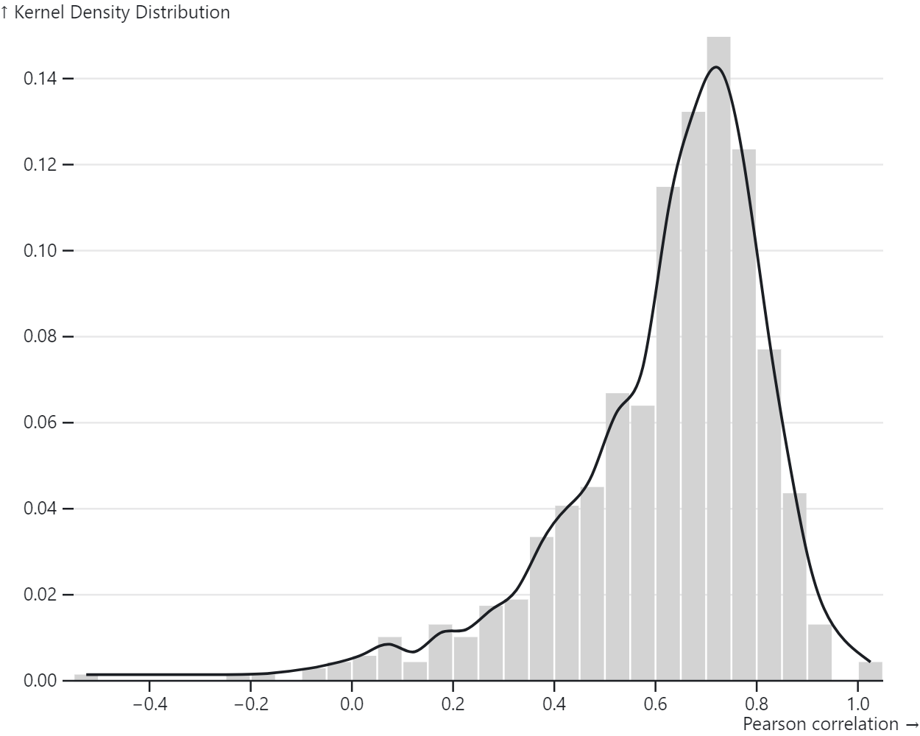
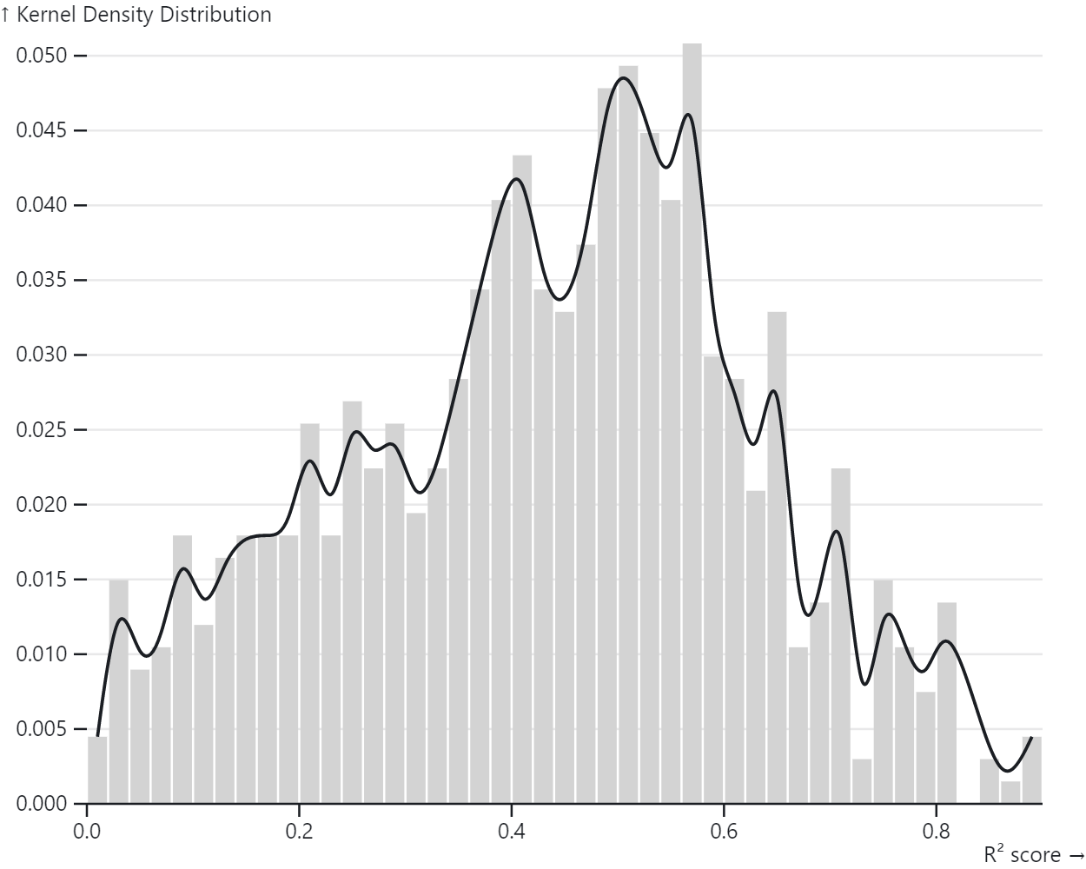
County Level
Notes:
Following the same methodology, I disaggregated the spatial scale further and investigated the temporal relationship between hashtag activism and physical protest counts at the county level. Once again, I modelled this relationship as a power regression function (yn=mxbn) for each of the U.S.’s 3006 counties (986). Results from this analysis are illustrated in this slide, where the obtained Pearson correlation values and R2 values are illustrated as kernel density distributions due to the large number of counties analysed. This figure shows that, on average, county level correlation values are positive and relatively high. However, the right subplot also shows that while a power regression is accurate in a majority of counties, there are also a substantial number of counties that do not fit this model.
One reason for this could be the lack of data-points available in some less densely populated counties.
Another could be that, in some counties, people are more likely to tweet than protest, or vice versa.

Slide 34
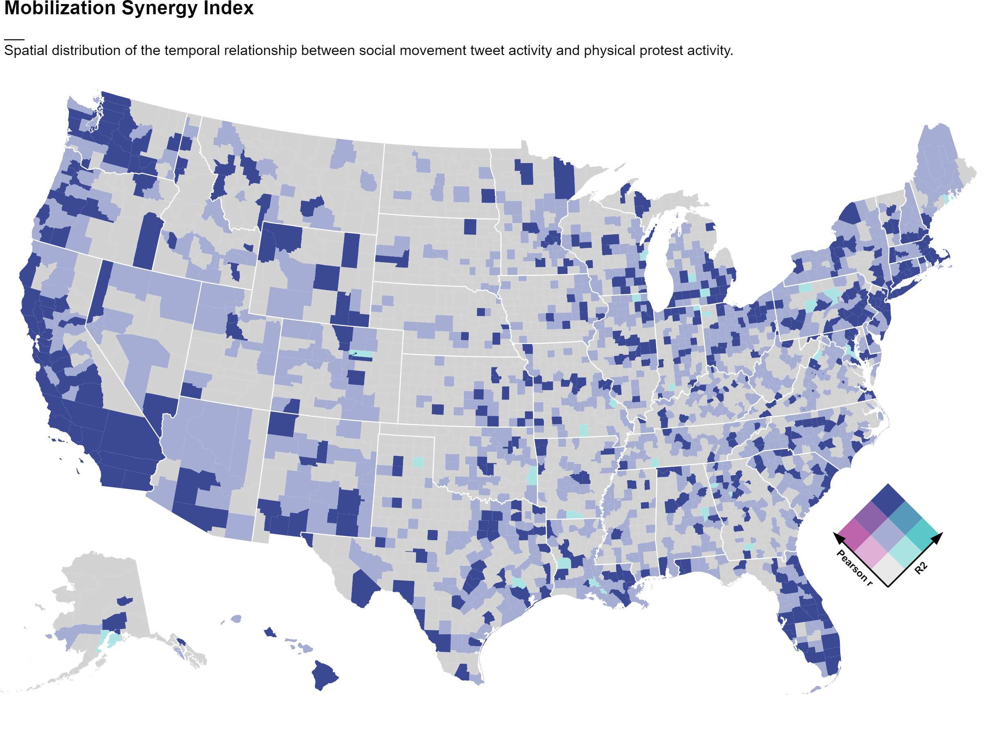
Notes:
Modelling the relationship between hashtag activism and physical protest at the county level can provide unique insight into which locations experience synergy across digital and physical activism mediums, and which do not. That is, it can help to identify which counties have activist groups that mobilize both digitally and physically, and thus where physical protests can be expected if people are already protesting on social media. Essentially, such counties are likely to be those where the power regression model yields both a high Pearson correlation value AND a high R2 value.
This type of classification is visualized in the form of a bivariate choropleth map in this slide.

Slide 35
Lagged Regressions
Directionality between xt and yt
In short: fit power regression model n times using yt data and x(t +- n)
t = current day
|n| = maximum number of time lags
Notes:
One way to study the directionality between two time series, xt and yt, is to identify lags of x that may be the best predictors of yt.
In the case of hashtag activism and physical protests, this method involves fitting a power regression model n times using the y data (daily physical protest counts) at time t and the x data (daily tweet counts) at n different time lags, where |n| is the maximum number of time lags.

Slide 36
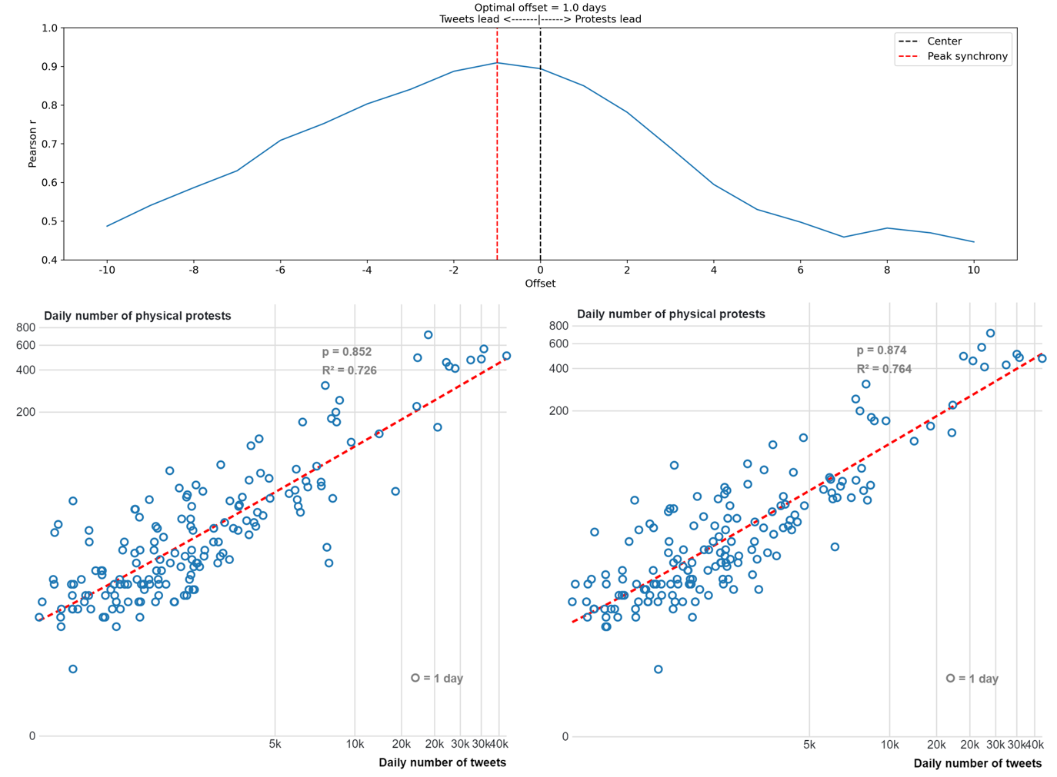
Optimal Lag = Tweets lead by 1 day
National Level
Notes:
In this slide, you can see the results of performing lagged regressions on national level data using a maximum time lag of n=10.
The top subplot shows that the optimal Pearson correlation value and R2 score is obtained when hashtag activism (i.e. daily number of tweets posted) leads physical protests by one day. In other words, at the national scale and during the case study of #JusticeForGeorgeFloyd, the best predictor of physical protest activity at time t (in days) is the number of social movement related tweets posted at time t−1 (i.e. the day before). This is relationship is further illustrated in the bottom subplot, where the outputs of power regression models using xt (left) and xt−1(right) can be compared.

Slide 37
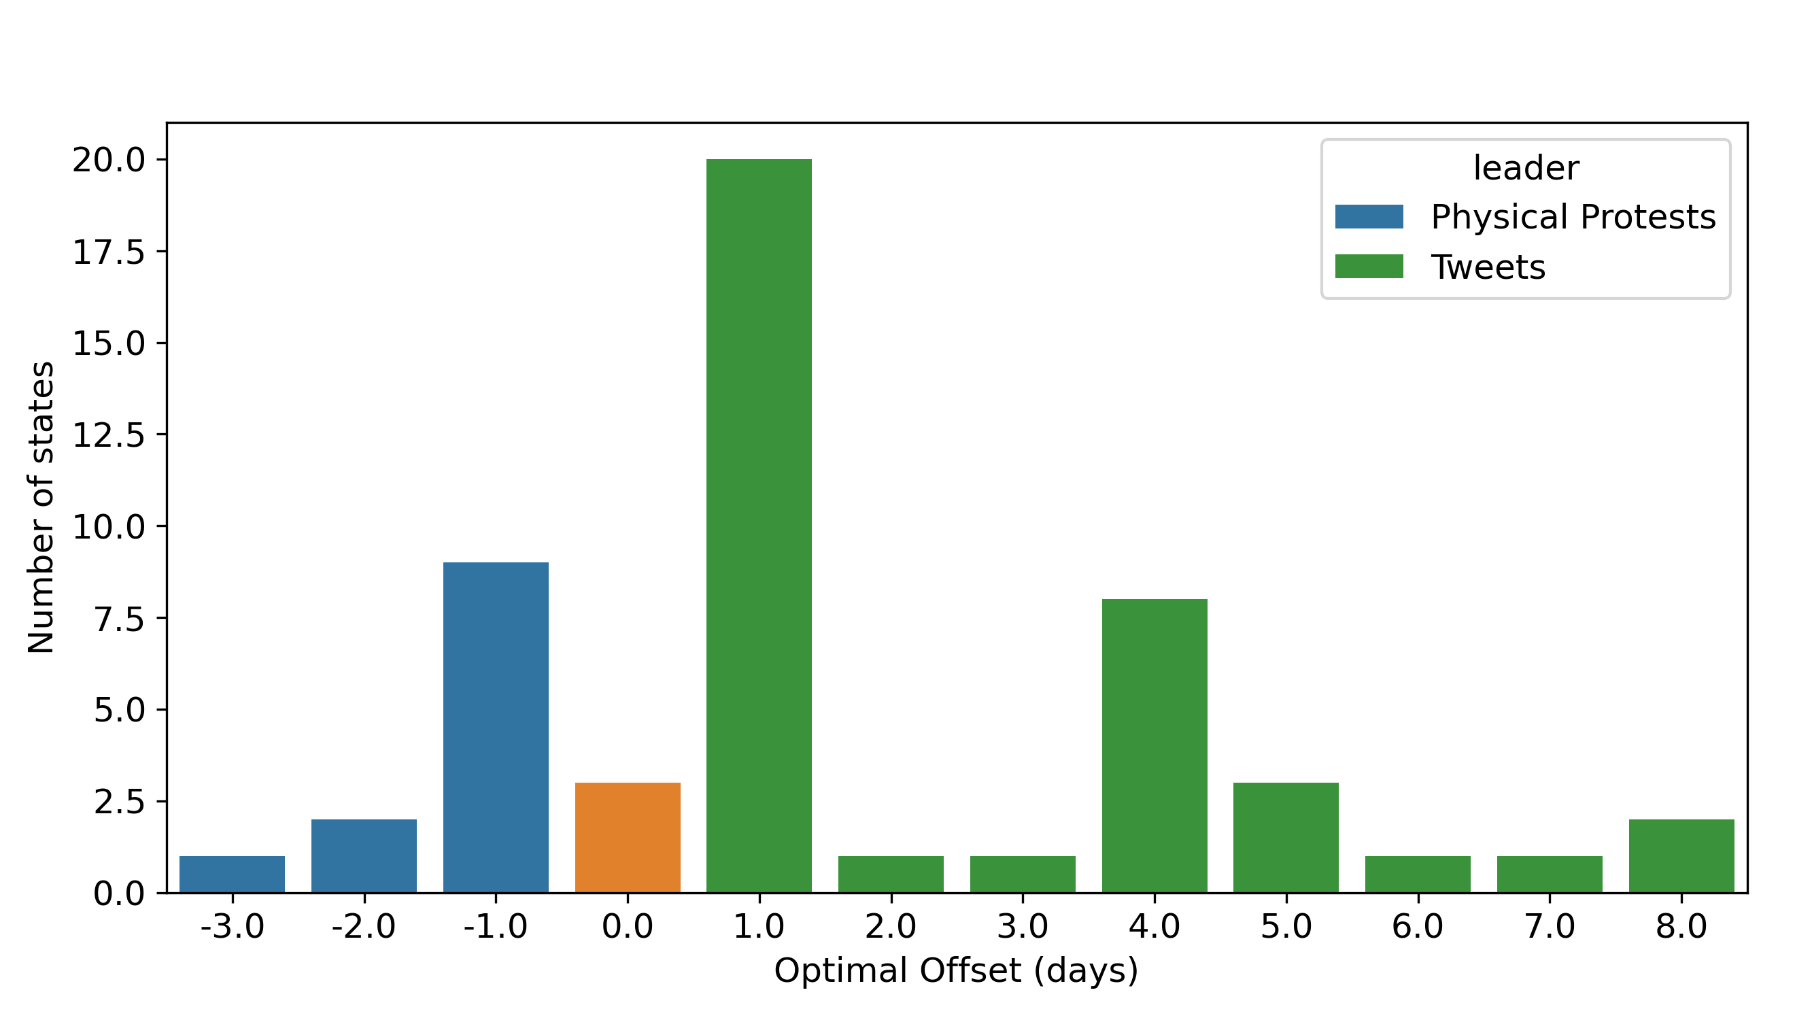
Optimal Lag = Tweets lead by: - 1 day in 20 states - 1+ days for 41 states
State Level
Notes:
Once again, lets look at the state level: in 41 out of 51 states the optimal Pearson correlation value is obtained when tweets lead by one or more days. For 20 of those states, the optimal Pearson correlation is obtained with a time lag of one day. These results are in agreement with other studies that have argued for a one day time lag between tweets and physical protest.

Slide 38
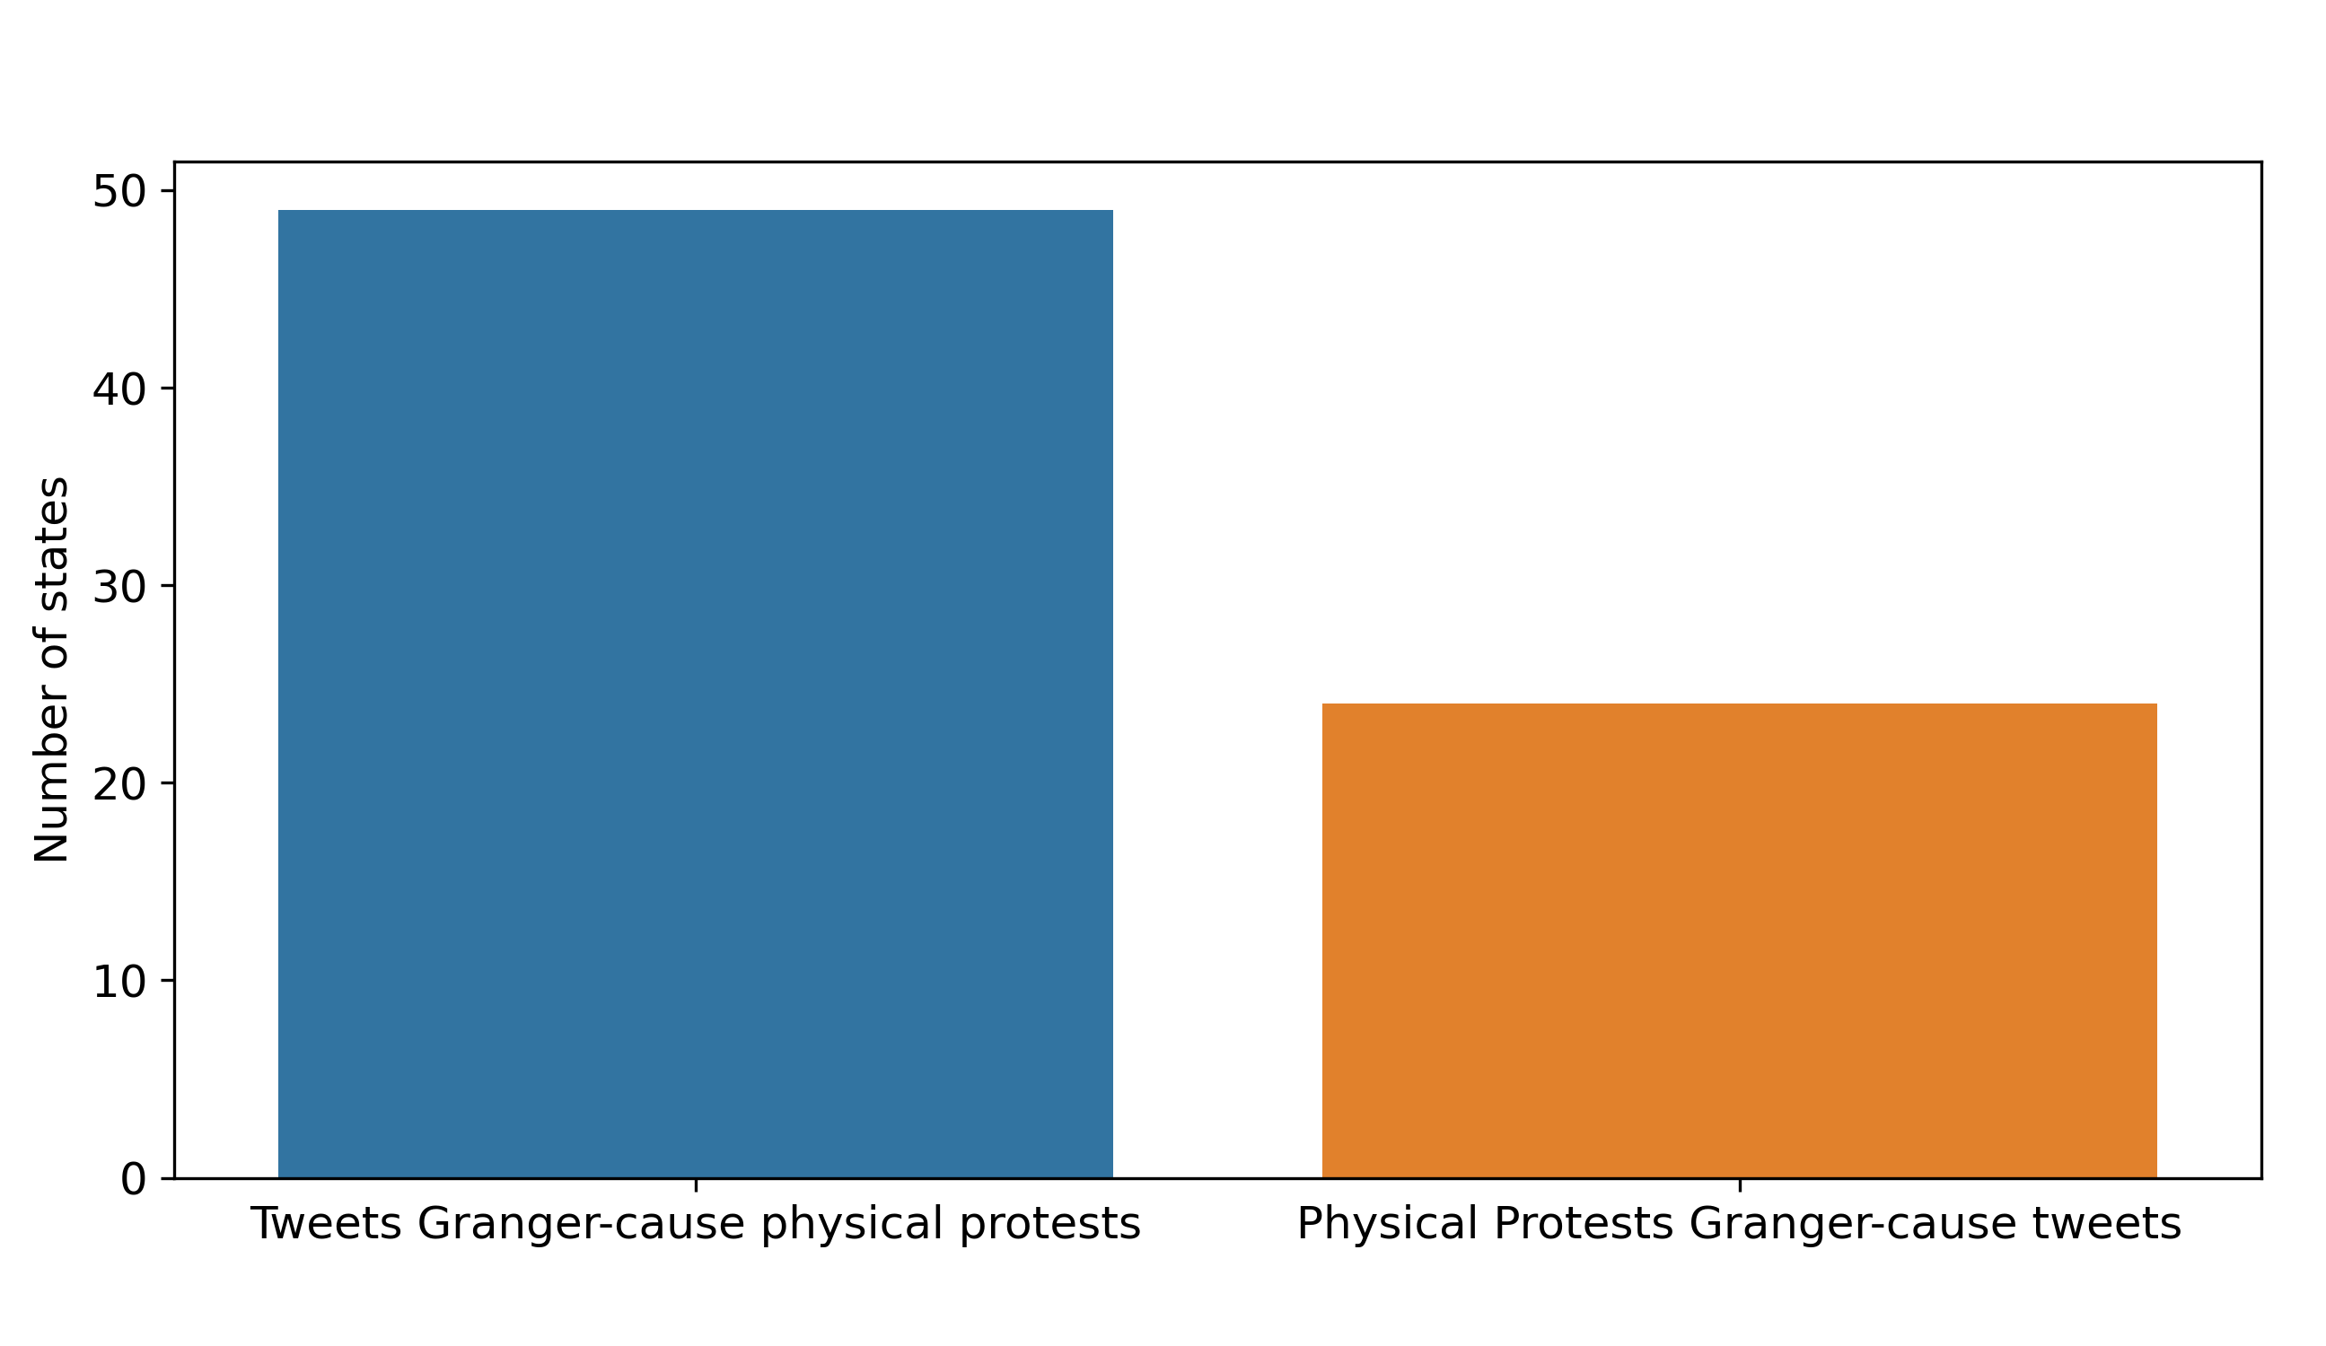
Granger Causality = Tweets Granger-cause physical protests in 49 out of 51 states Physical protests Granger-cause tweets in 24 out of 51 states
State Level
Notes:
Once again, lets look at the state level: in 41 out of 51 states the optimal Pearson correlation value is obtained when tweets lead by one or more days. For 20 of those states, the optimal Pearson correlation is obtained with a time lag of one day. These results are in agreement with other studies that have argued for a one day time lag between tweets and physical protest.

Slide 39
Next Steps
LSTM + VAR model to predict physical protests
Need help with this
Notes:
One way to study the directionality between two time series, xt and yt, is to identify lags of x that may be the best predictors of yt.
In the case of hashtag activism and physical protests, this method involves fitting a power regression model n times using the y data (daily physical protest counts) at time t and the x data (daily tweet counts) at n different time lags, where |n| is the maximum number of time lags.

Slide 40
Notes:
Let’s focus on one of the main outcomes of this research: What is the relationship between location-based hashtag activism and physical protest activity?
As I mentioned earlier, the study of the relationship between hashtag activism and physical protest has been inconclusive, with evidence both in support and against the existence of such a relationship. This, scholars conclude, is partly due to a lack of empirical research and the use of limited case studies. Additionally, most of the literature within this area of research has studied this relationship through a broad lens without considering the geo-spatial relationships that may exist between digital and physical protests. So, in an attempt to address this knowledge gap, I’m going to share some evidence, using the JusticeForGeorgeFloyd social movement as a case study, suggesting that there is in fact a strong temporal and spatial relationship between hashtag activism and physical protest.

Slide 41
Notes:
Let’s focus on one of the main outcomes of this research: What is the relationship between location-based hashtag activism and physical protest activity?
As I mentioned earlier, the study of the relationship between hashtag activism and physical protest has been inconclusive, with evidence both in support and against the existence of such a relationship. This, scholars conclude, is partly due to a lack of empirical research and the use of limited case studies. Additionally, most of the literature within this area of research has studied this relationship through a broad lens without considering the geo-spatial relationships that may exist between digital and physical protests. So, in an attempt to address this knowledge gap, I’m going to share some evidence, using the JusticeForGeorgeFloyd social movement as a case study, suggesting that there is in fact a strong temporal and spatial relationship between hashtag activism and physical protest.

Slide 42
Notes:
Let’s focus on one of the main outcomes of this research: What is the relationship between location-based hashtag activism and physical protest activity?
As I mentioned earlier, the study of the relationship between hashtag activism and physical protest has been inconclusive, with evidence both in support and against the existence of such a relationship. This, scholars conclude, is partly due to a lack of empirical research and the use of limited case studies. Additionally, most of the literature within this area of research has studied this relationship through a broad lens without considering the geo-spatial relationships that may exist between digital and physical protests. So, in an attempt to address this knowledge gap, I’m going to share some evidence, using the JusticeForGeorgeFloyd social movement as a case study, suggesting that there is in fact a strong temporal and spatial relationship between hashtag activism and physical protest.

Slide 43
Notes:
Let’s focus on one of the main outcomes of this research: What is the relationship between location-based hashtag activism and physical protest activity?
As I mentioned earlier, the study of the relationship between hashtag activism and physical protest has been inconclusive, with evidence both in support and against the existence of such a relationship. This, scholars conclude, is partly due to a lack of empirical research and the use of limited case studies. Additionally, most of the literature within this area of research has studied this relationship through a broad lens without considering the geo-spatial relationships that may exist between digital and physical protests. So, in an attempt to address this knowledge gap, I’m going to share some evidence, using the JusticeForGeorgeFloyd social movement as a case study, suggesting that there is in fact a strong temporal and spatial relationship between hashtag activism and physical protest.

Slide 44
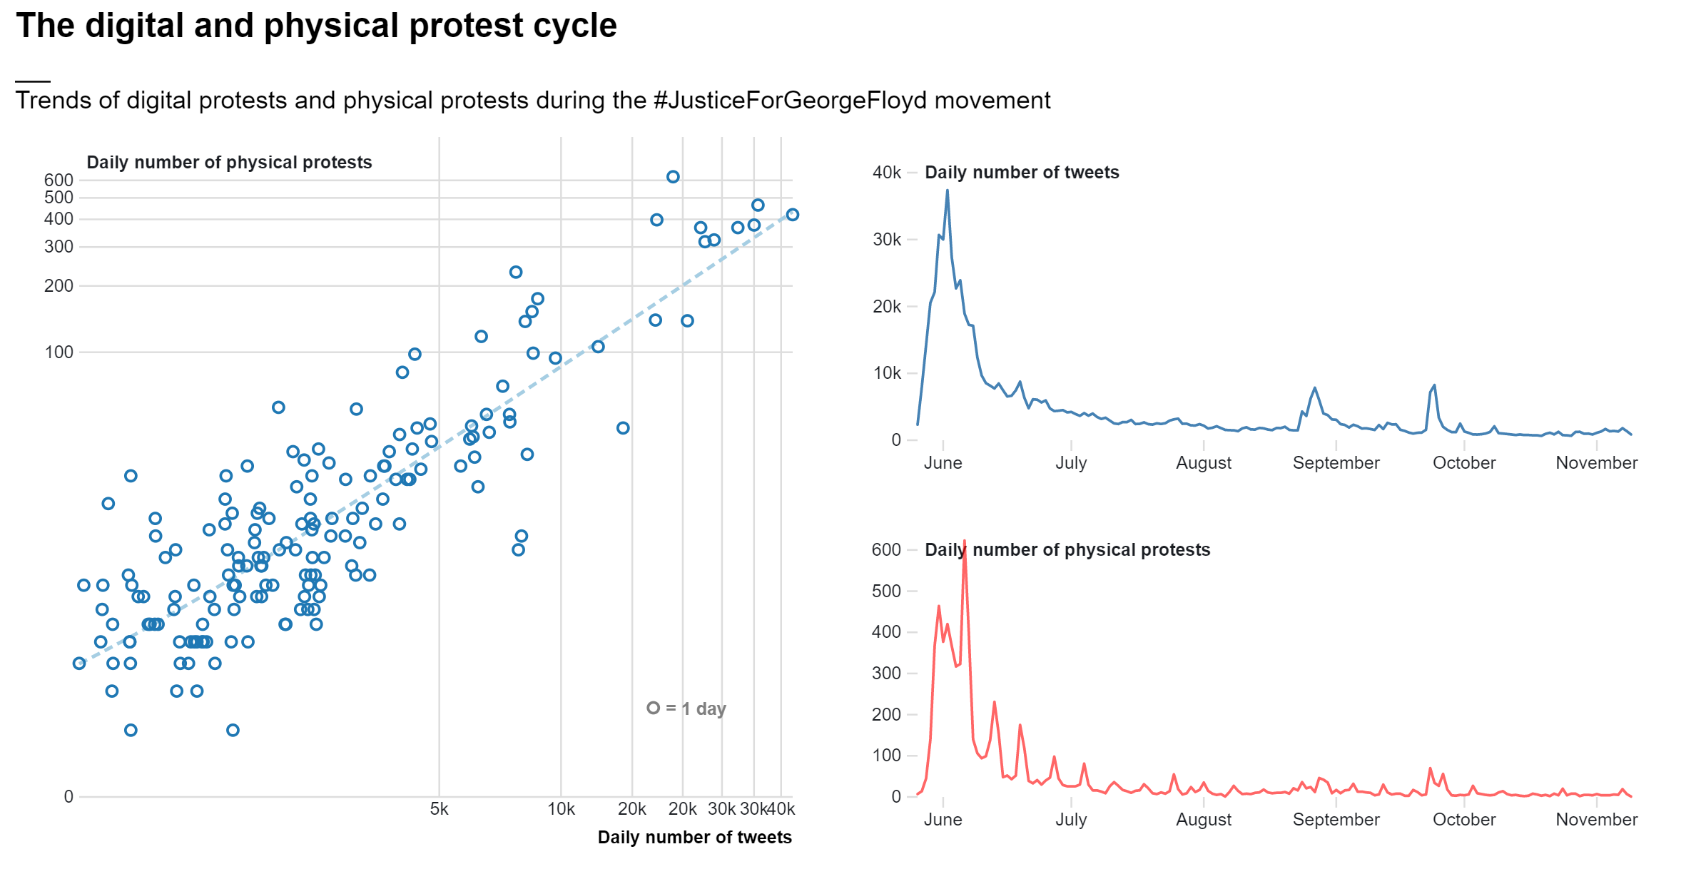
++
Digital Protest
Physical Protest
?
Notes:
This trend illustrates an intuitive cycle, where digital protest and physical protest interact together and amplify one-another. But it seems that tweet activity may be causing physical protest, and not the other way around.

Slide 45
Digital Protest, Physical Protest and Legislative Responses: Evidence from #JusticeForGeorgeFloyd
Notes:
Let’s focus on one of the main outcomes of this research: What is the relationship between location-based hashtag activism and physical protest activity?
As I mentioned earlier, the study of the relationship between hashtag activism and physical protest has been inconclusive, with evidence both in support and against the existence of such a relationship. This, scholars conclude, is partly due to a lack of empirical research and the use of limited case studies. Additionally, most of the literature within this area of research has studied this relationship through a broad lens without considering the geo-spatial relationships that may exist between digital and physical protests. So, in an attempt to address this knowledge gap, I’m going to share some evidence, using the JusticeForGeorgeFloyd social movement as a case study, suggesting that there is in fact a strong temporal and spatial relationship between hashtag activism and physical protest.

Slide 46
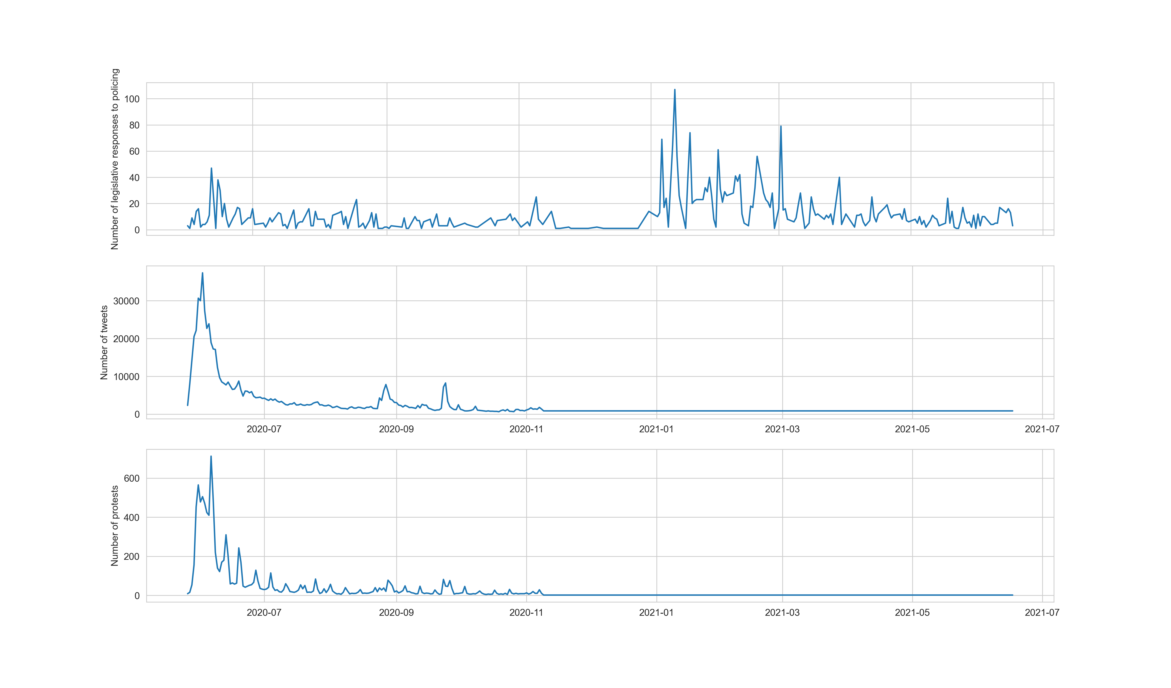
Legislative Responses
Tweets
Physical protests
Notes:
Let’s focus on one of the main outcomes of this research: What is the relationship between location-based hashtag activism and physical protest activity?
As I mentioned earlier, the study of the relationship between hashtag activism and physical protest has been inconclusive, with evidence both in support and against the existence of such a relationship. This, scholars conclude, is partly due to a lack of empirical research and the use of limited case studies. Additionally, most of the literature within this area of research has studied this relationship through a broad lens without considering the geo-spatial relationships that may exist between digital and physical protests. So, in an attempt to address this knowledge gap, I’m going to share some evidence, using the JusticeForGeorgeFloyd social movement as a case study, suggesting that there is in fact a strong temporal and spatial relationship between hashtag activism and physical protest.

Slide 47
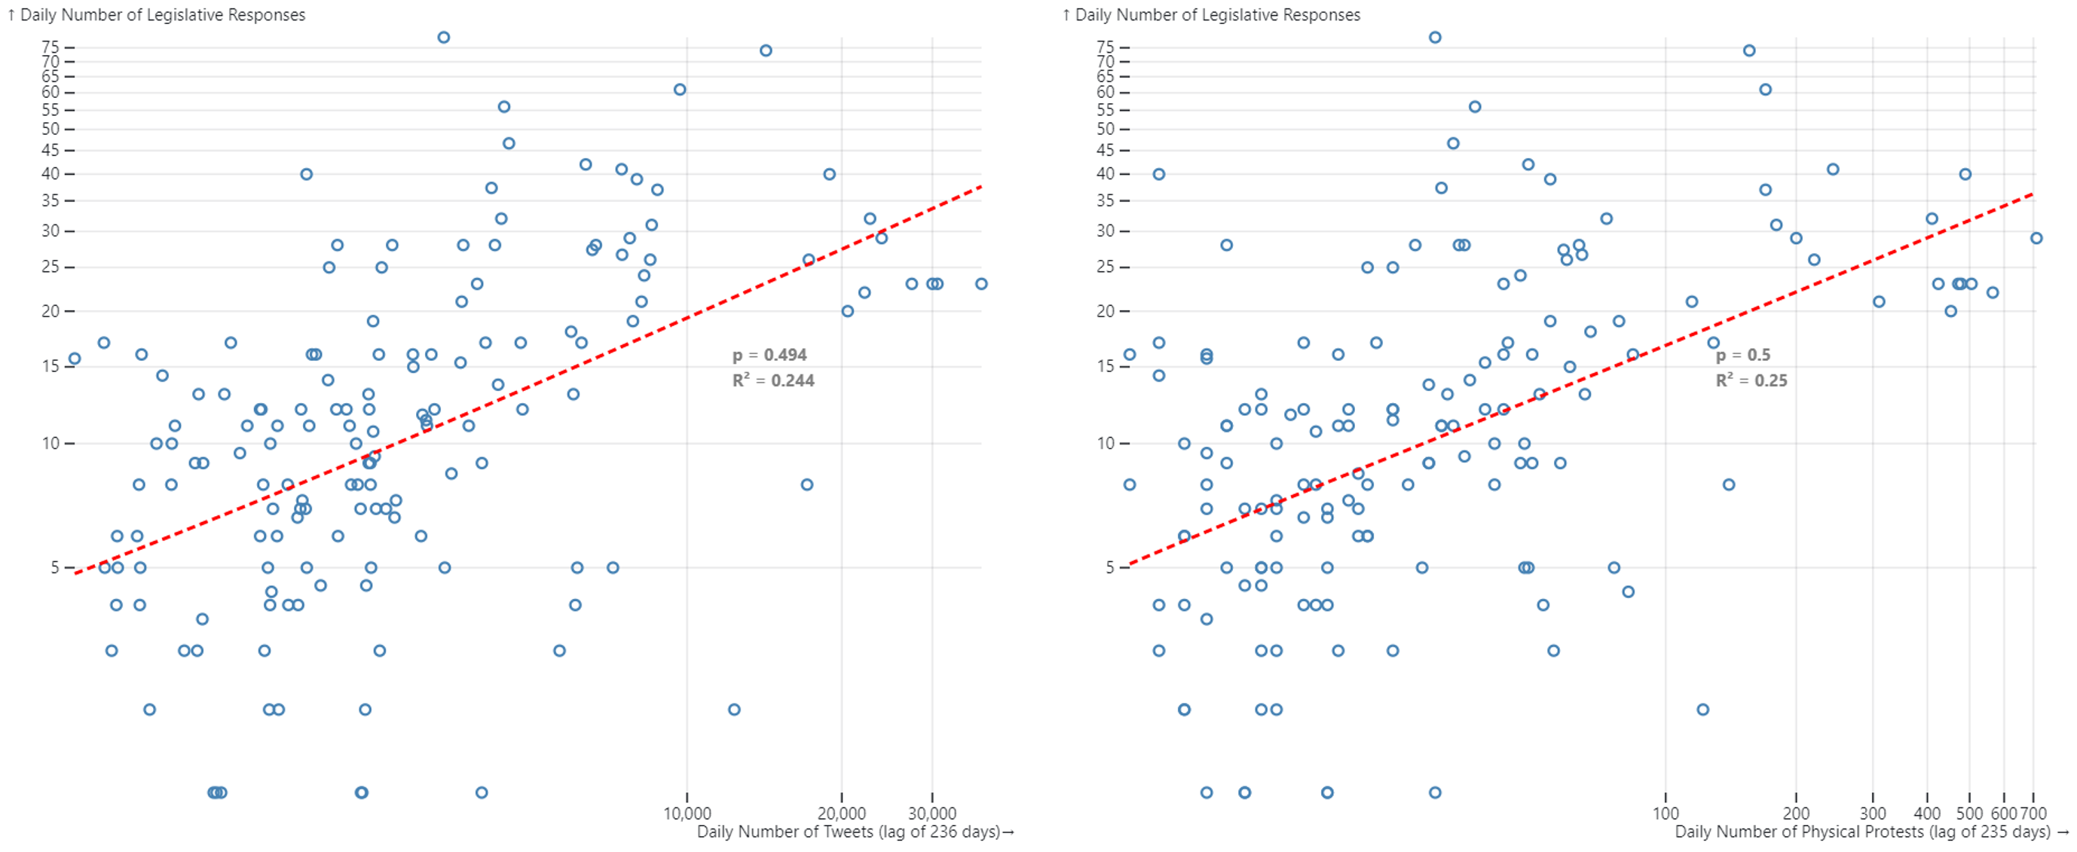
Optimal time lags
Tweets: 236 days before legislative responses
Physical Protests: 235 days before legislative responses
Notes:
Let’s focus on one of the main outcomes of this research: What is the relationship between location-based hashtag activism and physical protest activity?
As I mentioned earlier, the study of the relationship between hashtag activism and physical protest has been inconclusive, with evidence both in support and against the existence of such a relationship. This, scholars conclude, is partly due to a lack of empirical research and the use of limited case studies. Additionally, most of the literature within this area of research has studied this relationship through a broad lens without considering the geo-spatial relationships that may exist between digital and physical protests. So, in an attempt to address this knowledge gap, I’m going to share some evidence, using the JusticeForGeorgeFloyd social movement as a case study, suggesting that there is in fact a strong temporal and spatial relationship between hashtag activism and physical protest.

Slide 48
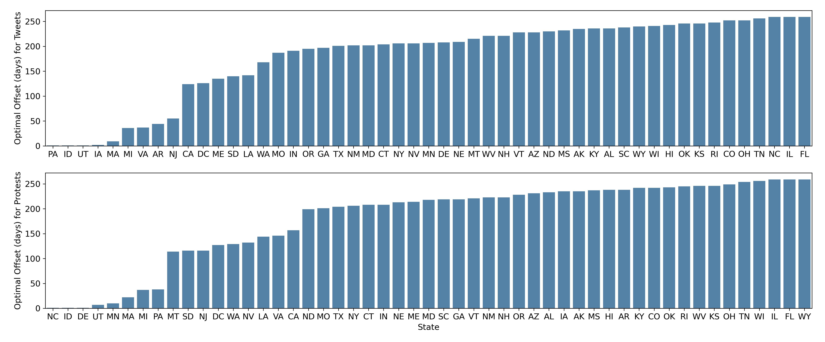
Optimal time lags
State Level: Why do some states act faster than others?
Notes:
Let’s focus on one of the main outcomes of this research: What is the relationship between location-based hashtag activism and physical protest activity?
As I mentioned earlier, the study of the relationship between hashtag activism and physical protest has been inconclusive, with evidence both in support and against the existence of such a relationship. This, scholars conclude, is partly due to a lack of empirical research and the use of limited case studies. Additionally, most of the literature within this area of research has studied this relationship through a broad lens without considering the geo-spatial relationships that may exist between digital and physical protests. So, in an attempt to address this knowledge gap, I’m going to share some evidence, using the JusticeForGeorgeFloyd social movement as a case study, suggesting that there is in fact a strong temporal and spatial relationship between hashtag activism and physical protest.

Slide 49
Next Steps
Granger Causality analysis
Notes:
One way to study the directionality between two time series, xt and yt, is to identify lags of x that may be the best predictors of yt.
In the case of hashtag activism and physical protests, this method involves fitting a power regression model n times using the y data (daily physical protest counts) at time t and the x data (daily tweet counts) at n different time lags, where |n| is the maximum number of time lags.

Slide 50
Notes:
Let’s focus on one of the main outcomes of this research: What is the relationship between location-based hashtag activism and physical protest activity?
As I mentioned earlier, the study of the relationship between hashtag activism and physical protest has been inconclusive, with evidence both in support and against the existence of such a relationship. This, scholars conclude, is partly due to a lack of empirical research and the use of limited case studies. Additionally, most of the literature within this area of research has studied this relationship through a broad lens without considering the geo-spatial relationships that may exist between digital and physical protests. So, in an attempt to address this knowledge gap, I’m going to share some evidence, using the JusticeForGeorgeFloyd social movement as a case study, suggesting that there is in fact a strong temporal and spatial relationship between hashtag activism and physical protest.

Slide 51
Notes:
Let’s focus on one of the main outcomes of this research: What is the relationship between location-based hashtag activism and physical protest activity?
As I mentioned earlier, the study of the relationship between hashtag activism and physical protest has been inconclusive, with evidence both in support and against the existence of such a relationship. This, scholars conclude, is partly due to a lack of empirical research and the use of limited case studies. Additionally, most of the literature within this area of research has studied this relationship through a broad lens without considering the geo-spatial relationships that may exist between digital and physical protests. So, in an attempt to address this knowledge gap, I’m going to share some evidence, using the JusticeForGeorgeFloyd social movement as a case study, suggesting that there is in fact a strong temporal and spatial relationship between hashtag activism and physical protest.

Slide 52
Notes:
Let’s focus on one of the main outcomes of this research: What is the relationship between location-based hashtag activism and physical protest activity?
As I mentioned earlier, the study of the relationship between hashtag activism and physical protest has been inconclusive, with evidence both in support and against the existence of such a relationship. This, scholars conclude, is partly due to a lack of empirical research and the use of limited case studies. Additionally, most of the literature within this area of research has studied this relationship through a broad lens without considering the geo-spatial relationships that may exist between digital and physical protests. So, in an attempt to address this knowledge gap, I’m going to share some evidence, using the JusticeForGeorgeFloyd social movement as a case study, suggesting that there is in fact a strong temporal and spatial relationship between hashtag activism and physical protest.

Slide 53
Notes:
Let’s focus on one of the main outcomes of this research: What is the relationship between location-based hashtag activism and physical protest activity?
As I mentioned earlier, the study of the relationship between hashtag activism and physical protest has been inconclusive, with evidence both in support and against the existence of such a relationship. This, scholars conclude, is partly due to a lack of empirical research and the use of limited case studies. Additionally, most of the literature within this area of research has studied this relationship through a broad lens without considering the geo-spatial relationships that may exist between digital and physical protests. So, in an attempt to address this knowledge gap, I’m going to share some evidence, using the JusticeForGeorgeFloyd social movement as a case study, suggesting that there is in fact a strong temporal and spatial relationship between hashtag activism and physical protest.

Slide 54
Problem: how to avoid unethical side effects?
Notes:
For me I am finding these findings fascinating, but also extremely scary. As someone who strongly believes in the importance of physical protest and political mobilization as a means to influence change,
I know that these results could be used both for good:
help activists organize and strategize better, by knowing which geographical areas are likely to take concrete action during times of crisis
Or for bad:
Help law enforcement predict where protests will happen, and thus repress demonstrators even more
As scientists, I think we have a strong social responsibility: so how do we prevent things like that from happening?

Slide 55
Questions
Feedback
Criticism
.
.
.
?

Slide 56
Is this interesting?
How to visualize this more effectively?
For low scores, it would be interesting to show why the score is low →
people protest more but don’t tweet
people tweet more but don’t protest
Notes:
Political mobilization processes such as hashtag activism and physical protest are complex in nature as they occur in uncontrolled environments where a multitude of influences are at play
For this reason, it is virtually impossible to establish causal relations between them. Still, some insight can be generated regarding the way in which these two processes may influence each-other in space and time.

Slide 58
Additional Findings
Built predictive model to forecast the number AND location of physical protests based on tweet volume
VAR (Vector Autoregressive Model)
Granger Causality
Can these findings be generalized to other social movements around the world?

Slide 59
Theoretical Framework
Political processes
Legislative responses
Social Movements
Physical protest
Hashtag Activism
Key Actors
Notes:
In building on top of the theoretical understanding that (networked) social movements can have political consequences, this research aims to leverage a relevant case study through a quantitative approach to provide an evidence based understanding of the political implications of hashtag activism. As such, this slide illustrates the theoretical framework that guides this research. Through this framework, and the use of the #JusticeFor-GeorgeFloyd social movement as a case study, the relationship between hashtag activism, physical protest,and legislative change are modelled and quantified

Slide 60
Political processes
How can location-based hashtag activism influence place-specific political processes in the United States?
SQ. What is the relationship between location-based hashtag activism and physical protest activity?
Legislative responses
Social Movements
Physical protest
Hashtag Activism
SQ. What is the relationship between location-based hashtag activism and legislative action?
Notes:
Let’s now focus on the third subquestion: what is the relationship between hashtag activism and legislative action

Slide 61
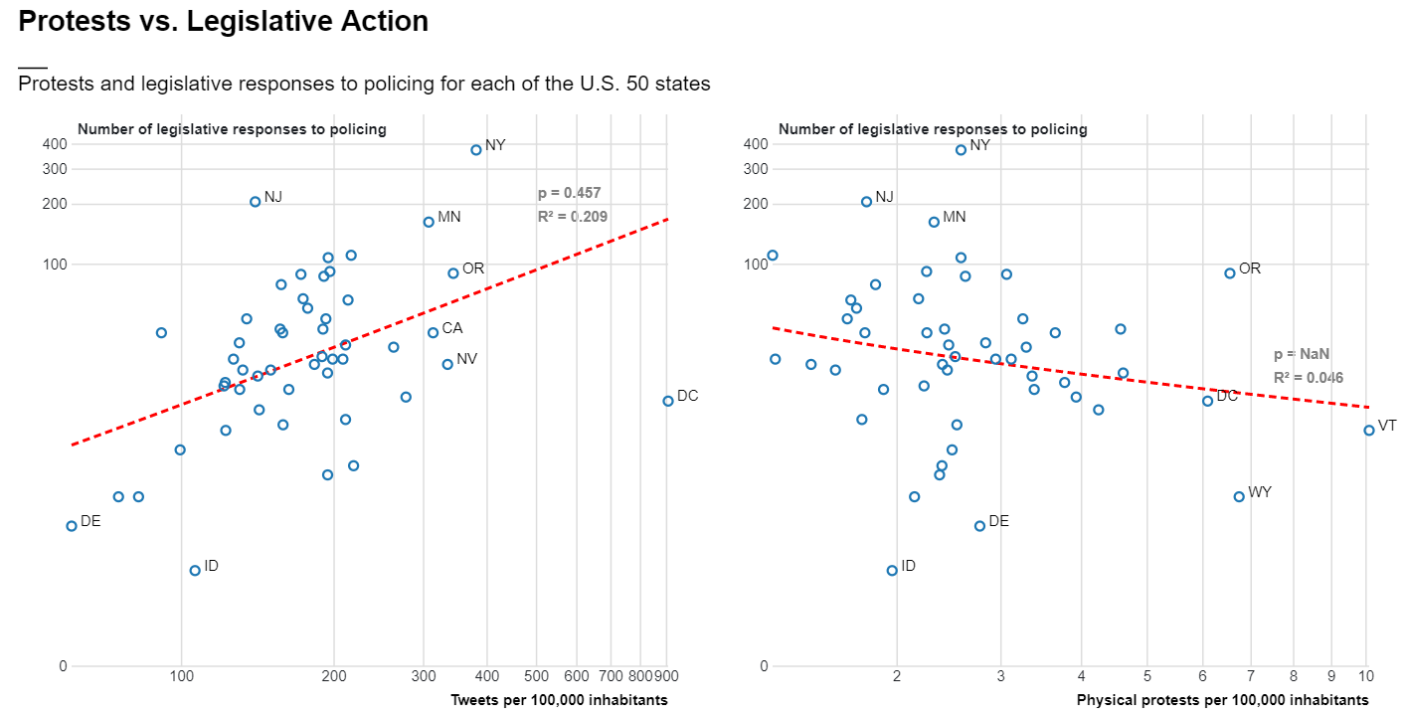
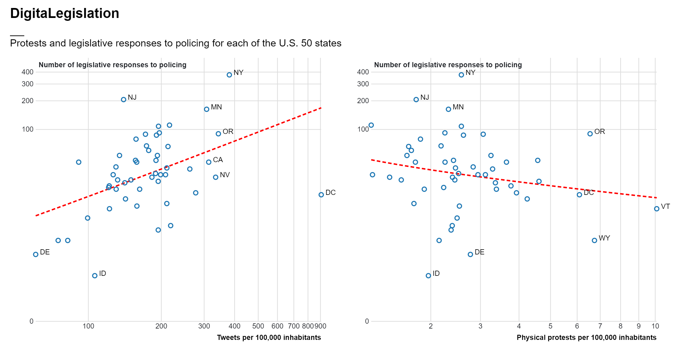
Notes:
So far, I have only looked at the relationship between total counts of legislative responses to police brutality and both tweet counts and physical protests counts
In this graph you can see…
Here the story is very much consistent with what we have previously observed: we observe a positive trend between the number of tweets per 100,000 inhabitants in a given place and the number of legislative responses to policing in that place

Slide 62
Notes:
on the other hand, absolute counts of physical protests bear no (or even opposite) relationship with subsequent state-level legislative change

Slide 63
digital protest in place x
=
more legislative responses in place x
physical protest in place x
=
less legislative responses in place x
Notes:
So, while more digital protest in one place is an indication of more legislative responses, more physical protests in one place is an indication of less legislative responses

Slide 64
Next steps
Currently only looked at total volume of both tweets and physical protests
Incorporate temporal dimension (correlated time series, granger causality etc)
Test regression model for prediction
Notes:
As an iterative process

Slide 65
Political processes
SQ. Who are the key actors involved in location-based hashtag activism for driving political processes?
How can location-based hashtag activism influence place-specific political processes in the United States?
SQ. What is the relationship between location-based hashtag activism and physical protest activity?
Legislative responses
Social Movements
Physical protest
Hashtag Activism
SQ. What is the relationship between location-based hashtag activism and legislative action?
Key Actors
Notes:
Let’s now focus on the las subquestion: Who are the key actors involved in location-based hashtag activism for driving political processes?
This section of my research is still very much in an exploratory phase, but I have made some initial steps in (I hope) the right direction

Slide 66
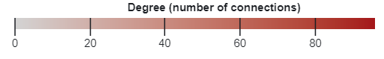
Notes:
In this slide you can see the social network from the #JusticeForGeorgeFloyd movement from May to November 2020, mapped in space. Where:
Each node/circle represents a user
Each link represents a connections between two users by means of retweet
The size and color of a node represents its degree, or the number of users it is connected to
The thickness of a link represents the strength of the connection between two users, or the number of times a user was retweeted by the same user
I have made an interactive visualization of this, which has proven very useful to get some initial insight into sources of influence during the case of #JusticeForGeorgeFloyd, in terms of:
who the most influential actors are
from what geographical locations are these actors excercing their influence
and finally, which geographical locations are these actors reaching through their social influence

Slide 67
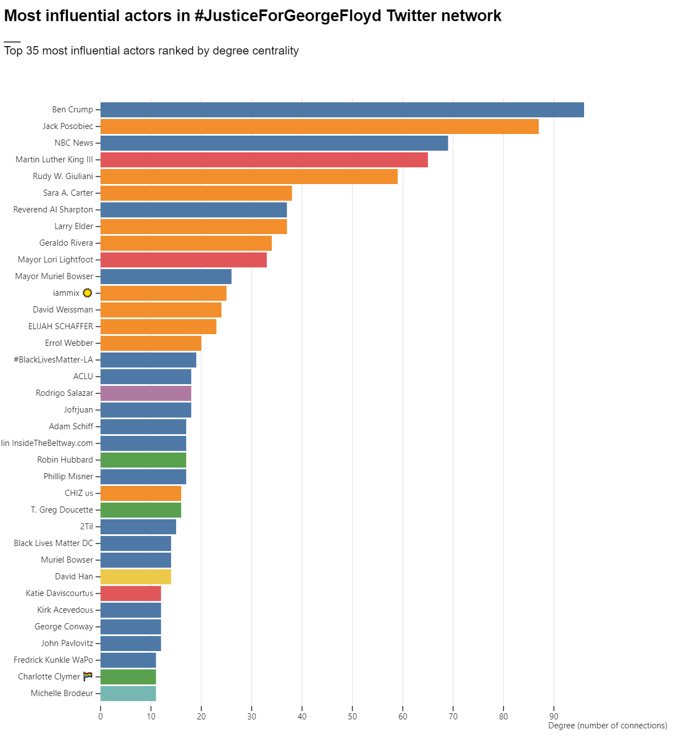
Community 1
Community 2
Community 3
Community 4
Community 5
Community 6
Community 7
Notes:
Through this network I was able to identify the most influential actors based on degree centrality during the #justiceforgeorge movement

Slide 68
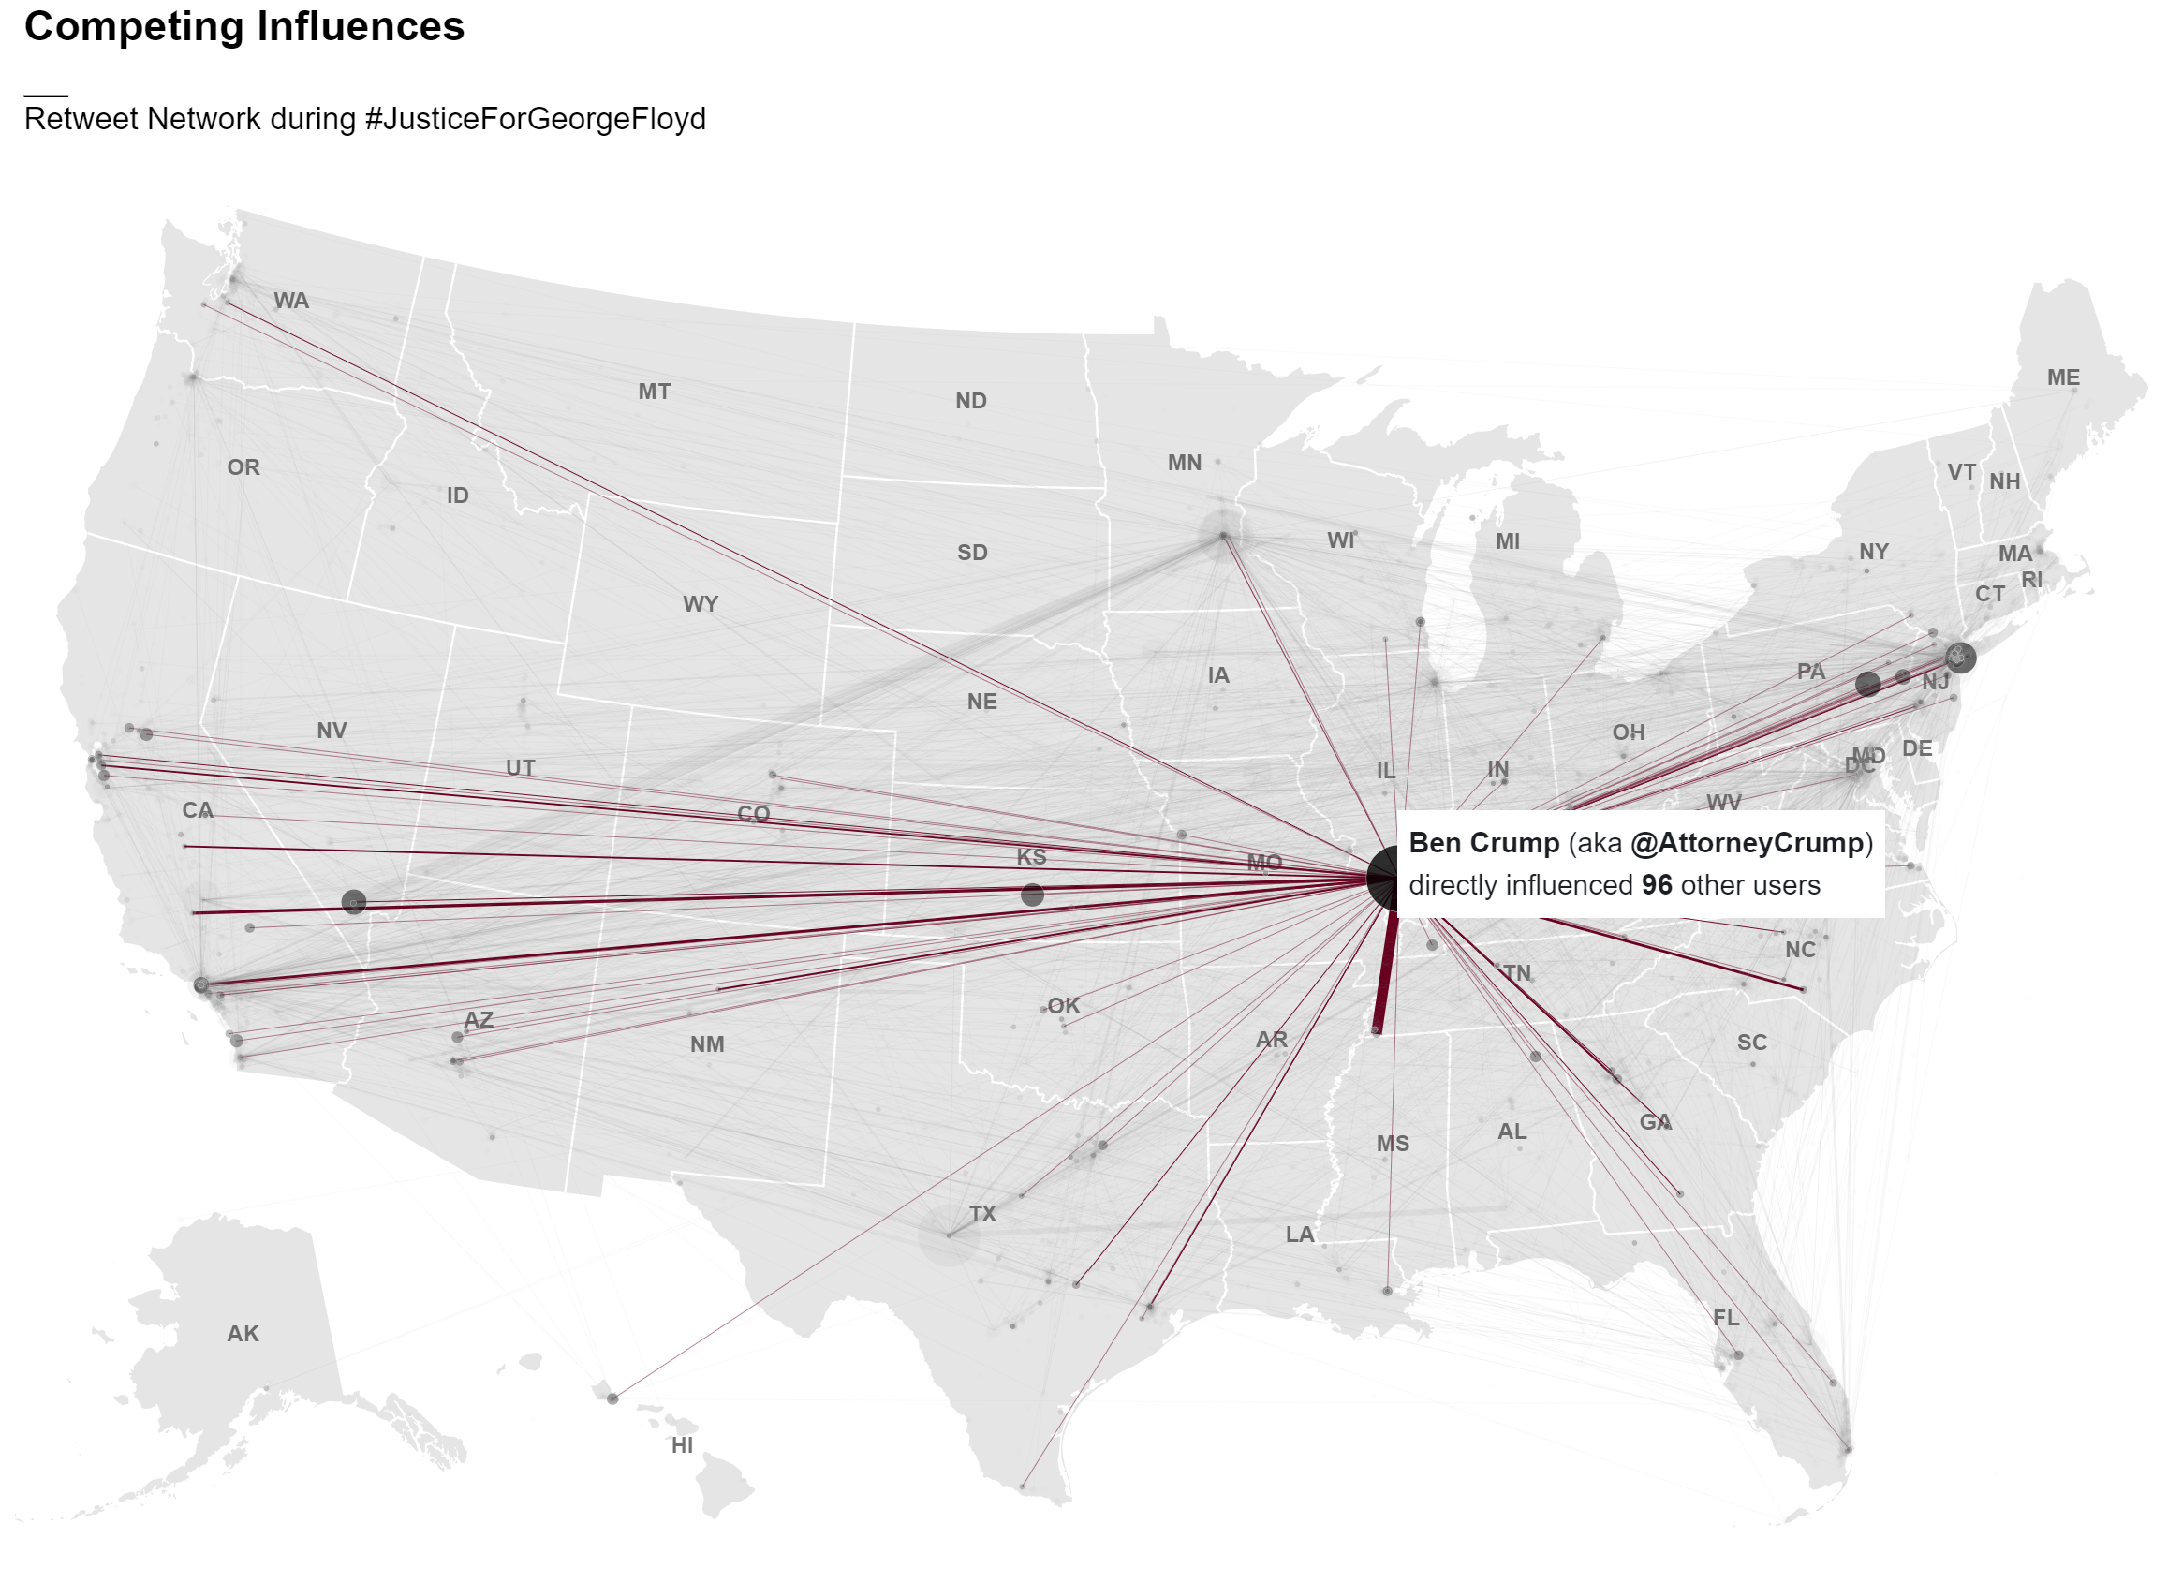

Slide 69
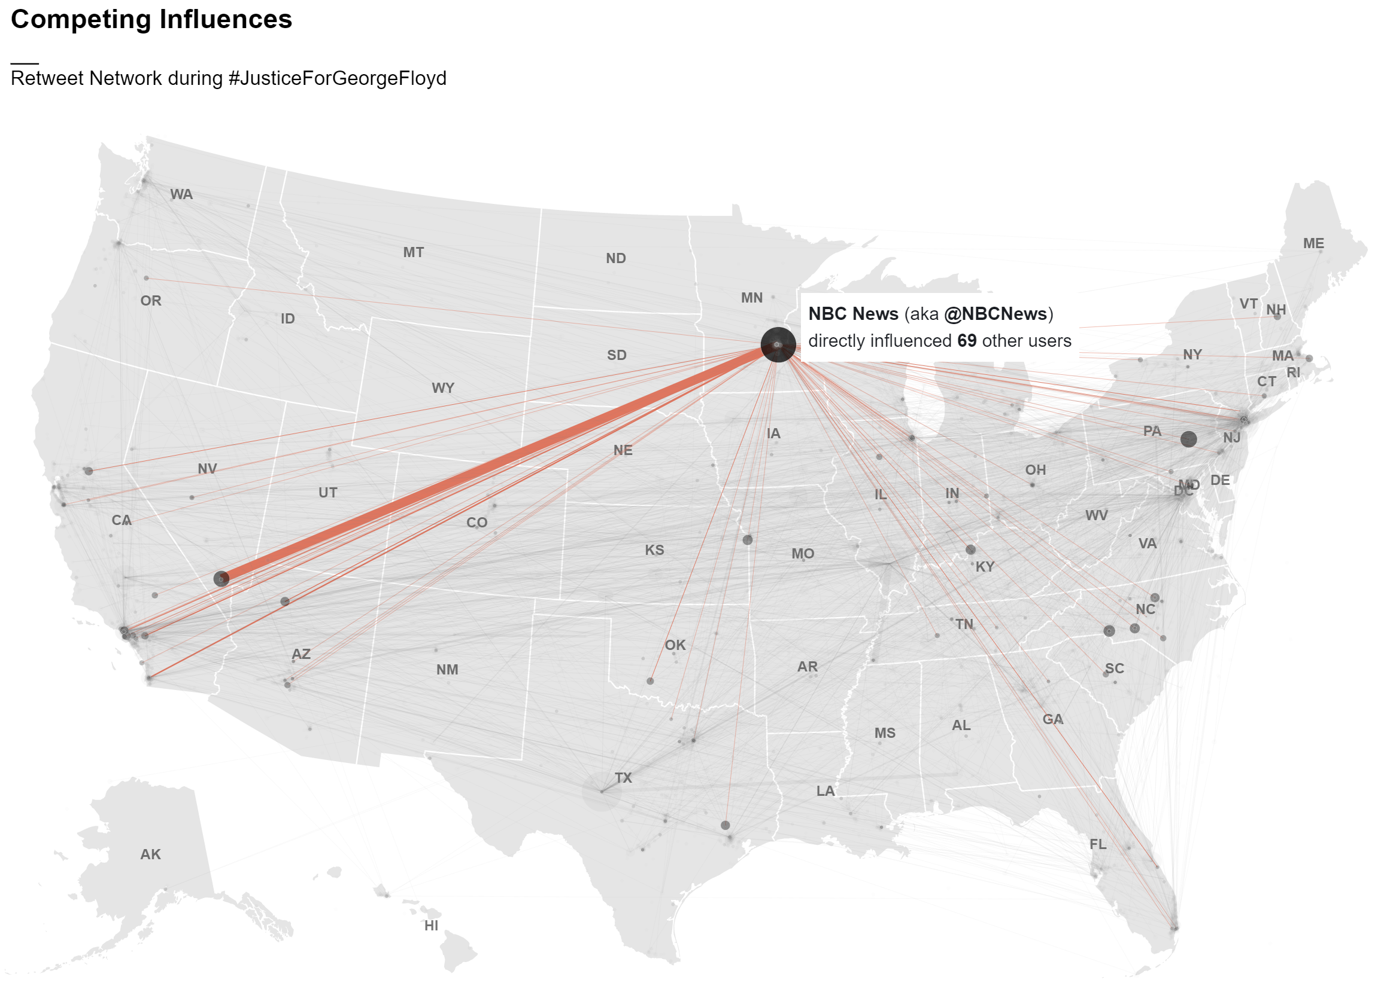

Slide 70
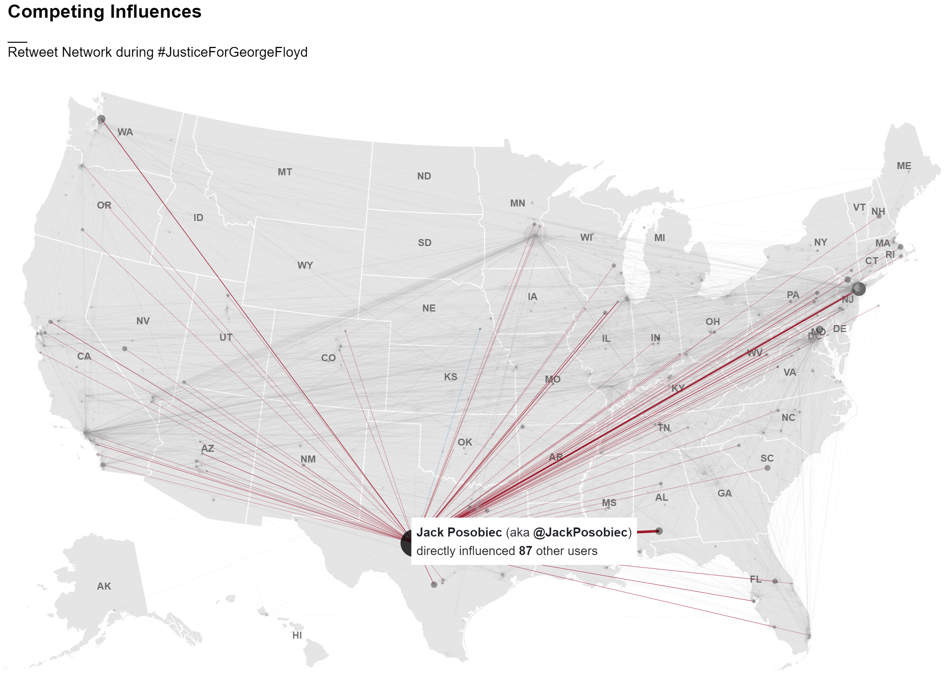

Slide 71
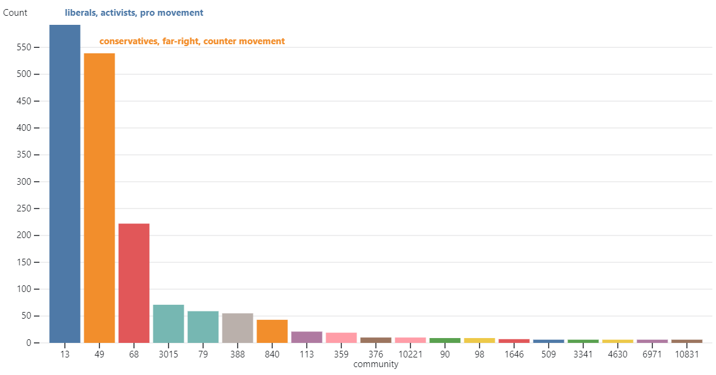

Slide 72
Next steps
Calculate more centrality metrics (betweenness, closeness, eigen)
Interpret key actors results
Interpret results of community detection
Relate network metrics with spatial relationships
Incorporate temporal element: model evolution of network over time (information diffusion over time)
Notes:
As an iterative process

Slide 73
where we are now…
SQ1: 50% of the way
SQ2: 80% of the way
SQ3: 60% of the way
Thesis report: 40% of the way
…where we are going…
Finish analysis (next 2 weeks)
Write methodology (next 2 weeks)
Write results, discussion and conclusion (second half of June)
Notes:
This is where I am at with this section of my thesis
Now I have some ideas of how to move forward:
Incorporate the temporal element in the network analysis
Leverage other net characteristics?
Repeat this analysis with the current socio political events happening as we speak

Slide 74

Methods
Case study of Justice For George Floyd
5 data-sets
1M geo-located tweets data from Twitter API
geo-located protest data from ACLED
data on legislatives responses to policing from NCSL
data on 2016/2020 county/precinct level election results
2020 census demographic data
Data Science approach
Web scraping
Geospatial data analysis
Network Analysis
ML (classification, regression, clustering)
Notes:
Finally I am using a Data Science approach for this research:

Slide 75
Methods
Case study of Justice For George Floyd
5 data-sets
1M geo-located tweets data from Twitter API
geo-located protest data from ACLED
data on legislatives responses to policing from NCSL
data on 2016/2020 county/precinct level election results
2020 census demographic data
Data Science approach
Web scraping
Geospatial data analysis
Network Analysis
ML (classification, regression, clustering)
iterative process
Notes:
As an iterative process

Slide 76
Trivik:
Logistical comment:
present each question in order
seek out social scientist to interpret results
Who the actors are in terms of characteristics: less about the personal name
Social science literature that suggests relationships through
Look at spatially lagged variables (neighbouring counties) lecture 6 or 5 exploratory spatial data analysis
Martijn:
Granger causality assumes that there is two variables at play: does it really make sense?
I want to challenge you a bit more in critically reflecting in what all does this mean
Focus on SQ2+3 finish analysis and discussion
Network:
Normalize network using entropy
Specific metrics that look at influence of people
Greenlight: readable from A-Z but not fully complete
Chap 4 (most stuff in appendix)
Case is really strong (GF): is this true for other movements? For movements without such a historical background, here it is a boiling pot ready to blow, but what about

Slide 77
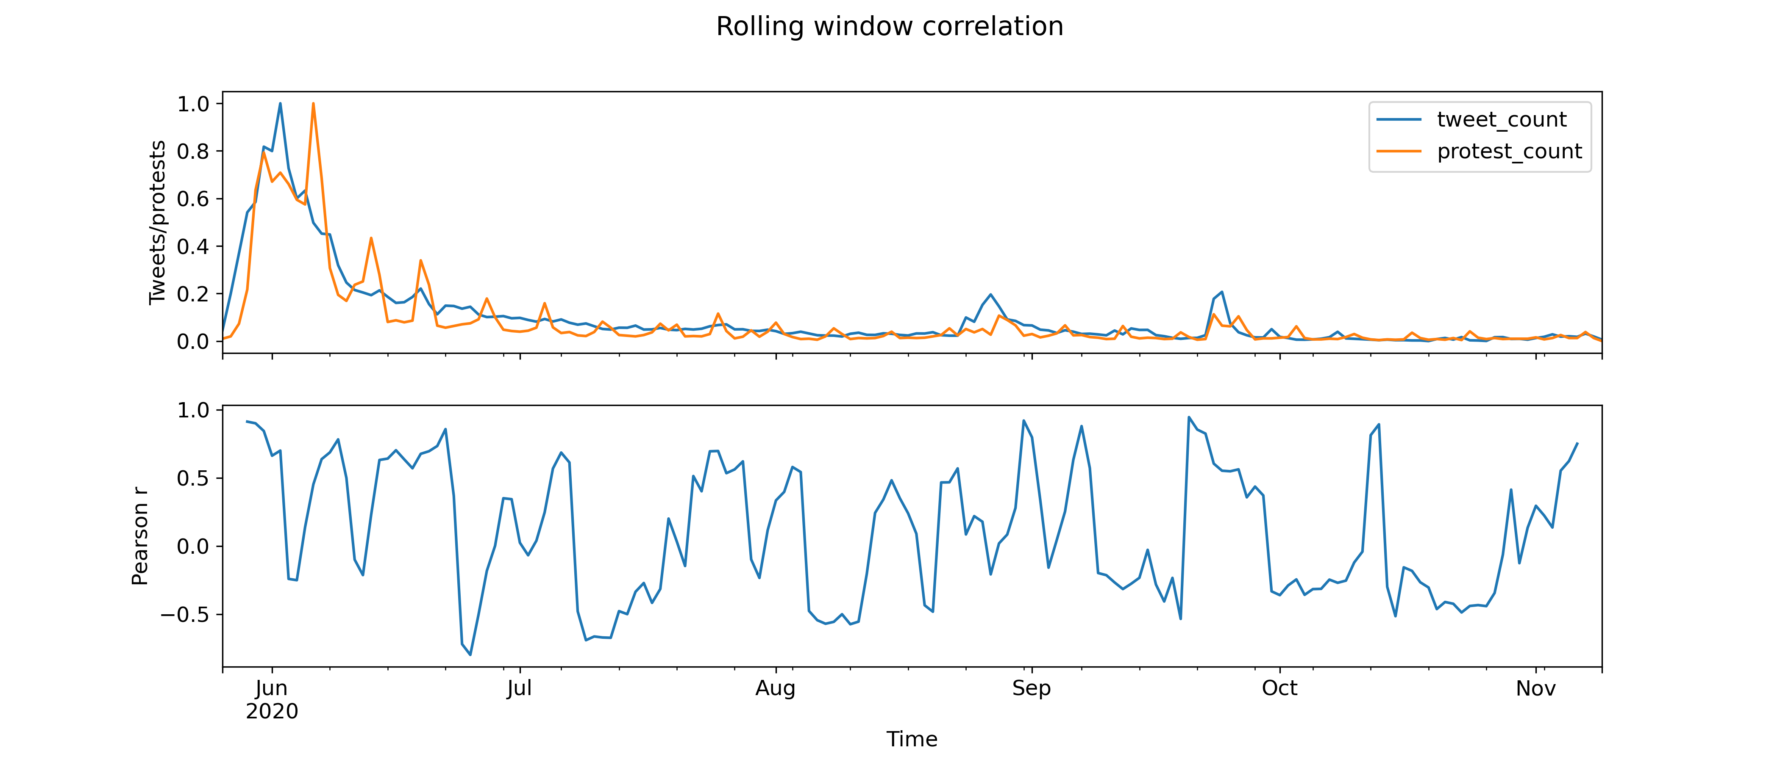
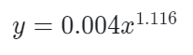
Notes:
Interestingly, I found that this relationship is even stronger when we use a time lag of 1 day for the tweet data. Meaning that tweets happen one day before protests

Slide 78
Knowledge Gap
Theoretical and anecdotal evidence that #activism can have real political consequences BUT
Lack of empirical evidence supporting this understanding through quantitative analysis
Existing research:
impact of #activism on physical protest: disagreement
impact of #activism on legislative action: barely exists
Unresolved questions:
can social media activity in a specific geographical area influence legislative action within that same area?
can social media activity in a specific geographical area be used to predict where and when physical protests will take place?
Notes:
Because location data from social media is hard to get, there is a lack of research regarding the geographical characteristics of social media movements and the role of space in determining the outcomes of these movements
Scholars who study social movements agree that the geographical characteristics are important but have not answered simple questions such as:
is twitter activity in a specific area more likely to influence political processes within that same area?
can the location from where activists tweet determine the location from where change happens?

Slide 79
Knowledge Gap
Theoretical and anecdotal evidence that #activism can have real political consequences BUT
Lack of empirical evidence supporting this understanding through quantitative analysis
Existing research:
impact of #activism on physical protest: disagreement
impact of #activism on legislative action: barely exists
Unresolved questions:
can social media activity in a specific geographical area influence legislative action within that same area?
can social media activity in a specific geographical be used to predict where and when physical protests will take place?
Geolocated social media data → relationship between hashtag activism and political processes (i.e. physical protest, legislative action)

Slide 80
Theoretical Framework
SQ. Who are the key actors involved in location-based hashtag activism for driving political processes?
Political processes
Legislative responses
Social Movements
Physical protest
SQ. What is the relationship between location-based hashtag activism and physical protest activity?
Hashtag Activism
SQ. What is the relationship between location-based hashtag activism and legislative action?
Key Actors
Notes:
In order to design this research, I’ve broken it up into different subquestions
First, I will look at who are the key actors involved in location-based hashtag activism for driving political processes? Network + demographic perspective
Which actors hold the most social influence over the general network of protest
are there specific socio-demographic groups that engage in hashtag activism more than others?

Slide 81
Theoretical Framework
SQ. Who are the key actors involved in location-based hashtag activism for driving political processes?
Political processes
Legislative responses
Social Movements
Physical protest
SQ. What is the relationship between location-based hashtag activism and physical protest activity?
Hashtag Activism
SQ. What is the relationship between location-based hashtag activism and legislative action?
Key Actors
Notes:
First, seeing as physical protest is the often been an enabler for social change, I will quantify and model the relationship between hashtag activism and physical protest

Slide 82
Theoretical Framework
SQ. Who are the key actors involved in location-based hashtag activism for driving political processes?
Political processes
Legislative responses
Social Movements
Physical protest
SQ. What is the relationship between location-based hashtag activism and physical protest activity?
Hashtag Activism
SQ. What is the relationship between location-based hashtag activism and legislative action?
Key Actors
Notes:
Finally, I will quantify and model the relationship between hashtag activism and legislative action?

Slide 83
Theoretical Framework
SQ. Who are the key actors involved in location-based hashtag activism for driving political processes?
Political processes
Legislative responses
Social Movements
Physical protest
SQ. What is the relationship between location-based hashtag activism and physical protest activity?
Hashtag Activism
SQ. What is the relationship between location-based hashtag activism and legislative action?
Key Actors
Notes:
First, seeing as physical protest is the often been an enabler for social change, I will quantify and model the relationship between hashtag activism and physical protest

